Slide 1

Life guidance for our time
Lecture series for increased life mastery and enjoyment of life
Course instructor: Per Hjalmar Svae
Session 9:
Deepening Soul and Spiritual Connection — Living from the Soul
Heart Room Self-development School hjerterommet.no

Slide 2
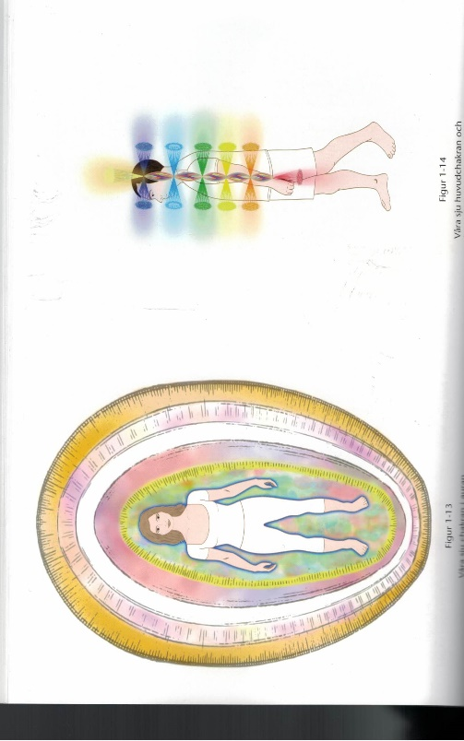
We Are on This Earth to Develop Our Maturity as Souls
Level | Maturity | Visual Color Scale | Guide status
6 | Highly developed | Dark blue-violet, radiant light | Master
5 | Developed | Light blue, gradu-ally traces of violet | Senior
4 | High intermediate | Dark yellow, gradu-ally traces of blue | Junior
3 | Intermediate | Pure yellow | None
2 | Low intermediate | Off-white, gradually traces of yellow | None
1 | Beginner | Clear white | None
Chakra with The Same Color
7. Crown
5. Throat
3. Solar Plexus
(1. Root - Red)
Source: Michael Newton: Journey of Souls – Case Studies of Lives Between Lives.
Source: Barbara Ann Brennan: Light Emerging – The Journey of Personal Healing.
According to Newton, ¾ of humanity are souls at an early stage of development.
The number of incarnations does not determine maturity — doing the inner work does.
Souls at the highest level stop incarnating.

Slide 3
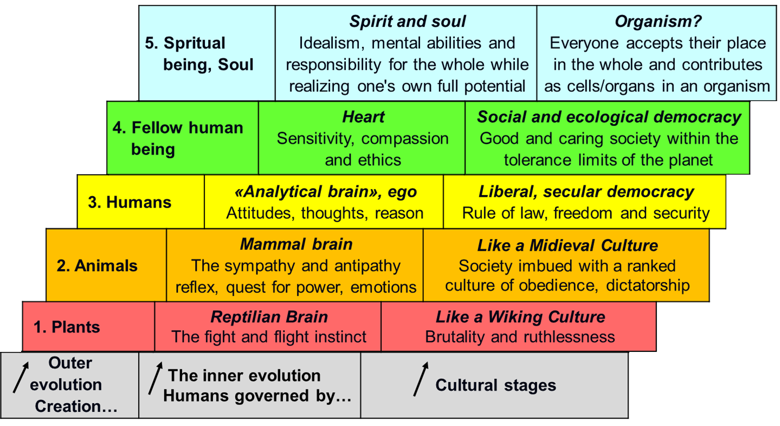
Positive and Negative Motivation
Positive motivation At the top three levels, it is security, trust and caring that govern emotions, thoughts and actions. → Create something
positive
The Development Ladder
(Explained in Lecture 1)
Negative motivation
At the two lowest levels, fear, distrust and greed (egoism) control emotions, thoughts and actions.
→ Create something
negative

Slide 4
The Map of Consciousness by David Hawkins – Feelings on The Development Ladder
 | Level -Feeling | Emotion | What is Created | Energy |  | Focus
7 | Enlightenment | Ineffable | Pure Consciousness | 700 - 1000 |  | Being Being spiritual: Motivation over 500 → Increasing spiritual power.
6 | Peace | Bliss | Illumination | 600
6 | Joy | Serenity | Transfiguration | 540
5 | Universal Love | Reverance | Revelation | 500
 | Level -Feeling | Emotion | What is Created | Energy |  | Focus
5 | Reason, Wisdom | Understanding | Abstraction | 400 |  | Doing Doing your best: Motivation over 200 → The positive will increase
4 | Acceptance, Love | Forgiveness | Transcendence | 350
4 | Willingness | Optimism | Intention | 310
4 | Trust – Positive | Neutral | Release | 250
3 | Courage | Affirmation | Empowerment | 200
 | Level -Feeling | Emotion | What is Created | Energy |  | Focus
3 | Pride | Scum | Inflation | 175 |  | Having Egoism: Motivation under 200 → The negative will increase.
2 | Anger | Hate | Aggression | 150
2 | Desire | Craving | Enslavement | 125
2 | Fear | Anxiety | Withdrawal | 100
1 | Grief | Regret | Despondency | 75
1 | Apathy | Despair | Abdication | 50
1 | Guilt | Blame | Destruction | 30
1 | Shame | Humiliation | Elimination | 20

Slide 5
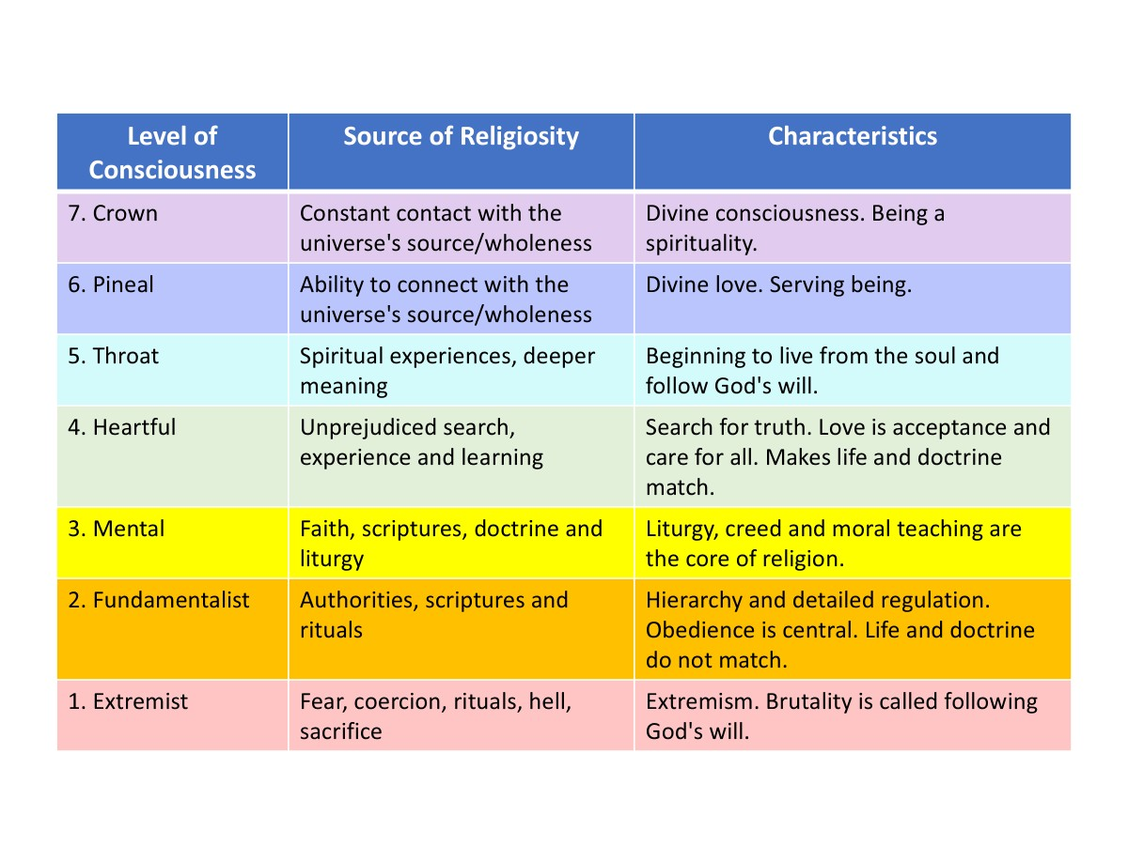
From Outer Religion to Inner Spirituality
Spirituality Inner religiosity
Religion
Priests interpreting holy books

Slide 6
Awakening – The Stages of the Process
Varighet
Hours, days, weeks, months
About like a crush
Months up to many years
Many years, ev. mixed with previous phase
Many years, ev. mixed with previous phase
The rest of
your live
Awakening
Spontaneous: A “random” contact with the heart’s depth, the soul, and spirit.
Ego collapse: Life has fallen apart and you must find a new meaning.
Bliss
The heart is open and guided by spirit. A wonderful experience.
You feel like a new person, the world is brighter, and everything has meaning.
The Soul’s Dark Night – Emerging from Level 2 and 1 Emotions and Behaviors
We’ve opened not only upward, but inward and downward.
Repressed emotional memories surface, and negative karma catches up.
The old ego is dying, and something new is being born.
The Void – Beginning to Function from Heart, Soul, and Spirit
We reprogram the ego to serve the heart and soul.
You become “alternative.” The process seems stagnant, but it takes time.
Grounding – Becoming a Heart-Centered Human, a Soul and Spiritual Being
We learn to endure and handle intense experiences and energies.
We settle into our new identity and consciousness.
Spiritual contact and guidance increase.
Living from the Heart, Soul, and Spirit
The ego and subtle energy system have rebuilt themselves.
Now it’s about fulfilling the true purpose of our lives.
Source on the internet: Core Spirit: «Six Life Changing Stages of Spiritual Awakening –
The Journey Of The «Lone Wolf»». Original source: Christina Lopez – The Heart Alchemist.

Slide 7
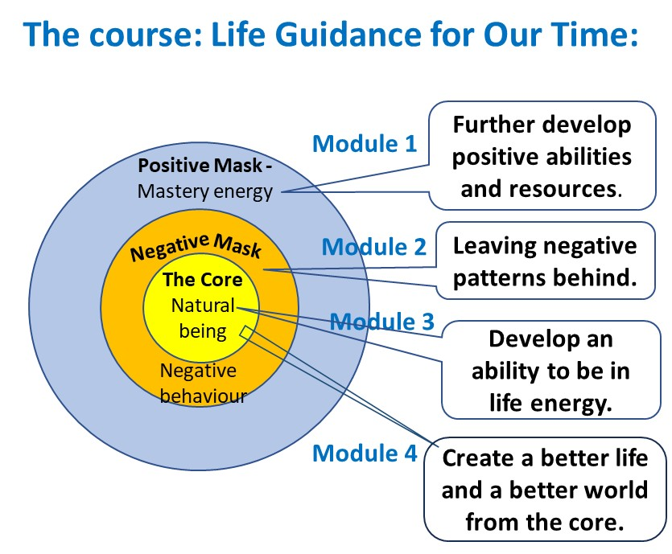
Awakening – Making deep contact
with the heart, soul and spirit
Awakening as a
Six Stages Process
Awakening Modul 3
Bliss Modul 3
The Soul’s Dark Night – Emerging from Level 2 and 1 Emotions and Behaviors Modul 2
The Void – Beginning to Function from Heart, Soul, and Spirit Modul 3 + 1
Grounding – Becoming a Heart-Centered Human, a Soul and Spiritual Being
Modul 3 + 1
Living from the Heart, Soul, and Spirit
Modul 4 + 3 + 1
+ All kinds of courses, therapy, healing, etc.
to get help at all stages

Slide 8
Tools in the process of gaining increasing contact with the soul and the spiritual world

Slide 9


To have increased contact with your soul
Humans have three spiritual energy centers: throat center, pineal center and crown center.
The heart center is the bridge
between the earthly and the spiritual
The heart is the gateway to the soul.
By listening to and following the heart’s voice, you can gradually connect with the soul.
  The heart expresses your everyday
  desires and needs.
  The soul speaks through your heart’s deepest longing and needs.
The soul is the gateway to the spiritual realm.
  With increased soul contact (throat chakra),
  your spiritual power grows, and you may connect more deeply with the spiritual world (pineal and crown chakras).
The human energy system.
Source: Barbara Ann Brennan:
Core Light Healing

Slide 10
Outer and Inner Purpose of Life
According to the theory underlying this course, every person chooses a purpose of life before incarnating.
Inner purpose of life= Self-development
→ To ascend the developmental ladder and become a more mature human.
→ May include specific tasks like developing patience or releasing anger.
Outer purpose of life = Individual mission
→ Can range from everyday roles (e.g., being a good teacher) to major achievements.
  → Ask yourself: “What would I love to do in
  this life, even if it seems unrealistic?”
  → You may be on to something…

Slide 11
Perceiving and Following Spiritual Guidance
Feel and follow emotions
→ What do you want? (Hara)
→ What do you feel in your heart?
→ What do you truly long for? (Soul)
Feel and follow intuition
→ Vague or sudden feelings,
impulses, sensations, inner knowing
Begin to follow spiritual guidance:
→ Notice and interpret signs and
synchronicities
Tools:
→ Wisdom cards, random book
openings, tarot cards (Crowley) &
book for interpretation (Zieglers)
Personal rule:
→ If it makes sense, take it seriously and follow up.
→ If not, reflect later or let it go.
Brennan’s rule:
→ You must act on the
guidance received
before receiving more.

Slide 12
Perceiving and Following Spiritual Guidance
Interpreting Dreams as Spiritual Guidance
Types of dreams:
Day residue dreams
Symbolic dreams
Recurring dreams
Nightmares
Light dreams (visions)
Lucid dreams
Prophetic dreams

Slide 13
Perceiving and Following Spiritual Guidance
Jungian dream interpretation
Dreams reflect aspects of yourself
All characters and animals = parts of you
Opposite gender = shadow side
The dream self = “is the fool”
The dream self normally does, think or feel the wrong things. What you resist is what you must integrate to
be a more whole and integrated person.
Everything is symbolic
What do you associate with people, things and events?
What is the general, archetypal interpretation of symbols?
Useful booklet: Benedicte Thiis: Symbols (the meaning of symbols, in Norwegian)

Slide 14
Perceiving and Following Spiritual Guidance
Intepreting vertical location of dream events
  Upper = Mental/spiritual
  Middle = Emotional
  Lower = Grounding/physical
Some usual archetypical symbols
Water = Emotions
House = Personality
Car = Ego
Death = Letting of something
  Some general principles
  Increasing flexibility from train, tram, bus, car, bike to walk
  Floor and numbers can possibly be interpreted as chakra levels
  Colors can be interpreted as chakra colors.
  Watching a movie = less integrated aspect than participating in something
  Other race = less integrated aspect than own race

Slide 15
Perceiving and Following Spiritual Guidance
Learning to interpret disease symbolically
Useful books: Louise Hay: Heal Your Body and You Can Heal Your Life.
Learning to interpret accidents symbolically
The spiritual theory is that you first receive small signs or warnings. If you don’t get it, events might increase in magnitude. If you don’t get it at all, the final sign or warning will be disease or accidents to help you stop, reflect and behave otherwise.
What you have to do is continously to try to interpret small signs and warnings symbolically.
In adittion you can:
Ask for channeling or guidance
from someone with such abilities

Slide 16
To develop higher awareness and increased contact with heart, soul and spirit
Summary
  To become better at remaining in inner peace and tranquility (Debrief faster after being triggered)
  Meditation and yoga – Practice quieting your thoughts. Mindfulness in everyday life – Witnessing awareness
  Having a spiritual practice of prayer, meditation and reflection (searching inward and “upwards”.)
  What we have been talking about is interpreting dreams and signs and following intuition and the voice of the heart and the longing of the soul.

Slide 17
Increasing Spiritual Power and Manifestation Ability

Slide 18
Releasing Creativity and Creative Power
Creativity comes from our spiritual power. The more spiritual connection you have, the more creative you will be able to be.
Using your imagination
Let your imagination run wild! Be open!
Let things happen! Be in life energy!
To ​​wish, long for and pray for something better
This is how you become like a magnet that attracts it.
To ask questions and be open to new answers
The most important thing is to ask the right questions.
Then the answers will come by themselves!
Several ways to find or get answers
Logical analysis
Practical experiments
Spiritual question and answer (pray, wait and receive)
Basic training in attracting what we want and long for:
Rhonda Byrne: The Secret. Book, film, videos.

Slide 19
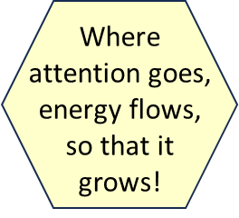
Applying Spiritual Creative Power
The Spiritual Success Formula
A burning desire
in your heart.
What you must do and have
Burning desire and determination
Unshakable faith and trust
Longing and vividly imagine, wish and pray for what you desire
A solid plan and follow-through
Mastermind group who helps you materialize what you want to create
Perseverance – Never give up
Have faith.
By putting emotion into it, you create enough spiritual energy for it to manifest.
When it comes to self-development: Focus on one thing at a time
Self-development: Easier to develop by participating in a group
If you don't give up, you'll make it. ☺
This is a summary of Napoleon Hill's book:
Think and Grow Rich. Original edition 1937.

Slide 20
Aah meditation to get in tune with the frequency of the quantum field where manifestation occurs
Schumann resonance is when our brain waves resonate with the Earth's magnetic field, i.e. a frequency equal to 7.83hz. We are then in a state of deep meditation, between alpha and theta brain waves.
This brain frequency controls our creativity.
It also contributes to improved learning/memory, body
rejuvenation, balance, improved stress tolerance, anti-jet lag, etc.
Wayne Dyer – Explanation of Aah and Ohm Meditation (Alpha-Omega) Wayne Dyer wrote the book “Your Erroneous Zones). https://youtu.be/3wZTPjpBGe0?si=LXHoVJju6GLtCrug
Aaah-meditasjon – Only sound – To activate your highet consciousness
Seek for «Ah Meditation for instant manifestation»
https://youtube.com/watch?v=2erTe3IgUjg&si=S3MNjvPKy-jsR-je

Slide 21
To Live as a Spiritual Being

Slide 22
Living from the Soul and Spirit
You know that you are an eternal spirit who has incarnated in a body on this earth, and who returns to the spirit world when the body dies.
You know that the meaning of life on earth is that you should develop as a soul and realize the life task you chose for this incarnation.
You have a spiritual practice of prayer, meditation, reflection and affirmation (visualization).
You increasingly practice mindfulness in everyday life and have a witnessing consciousness.
You are a fellow human being. Your heart tells you what you want and pray for and what is right and wrong, true and false.
You perceive and follow spiritual guidance. You experience meaningful coincidences, guidance from dreams and signs. You have learned to ask questions and wait for answers. You have learned to notice energy and interpret what happens symbolically. And you follow the guidance.
You use spiritual creative power to manifest the good in the physical world. Increasingly and more quickly, what you want and pray for comes to you.
In the best case, the pineal chakra also opens and you begin to experience the spiritual contact and the spiritual world directly.

Slide 23
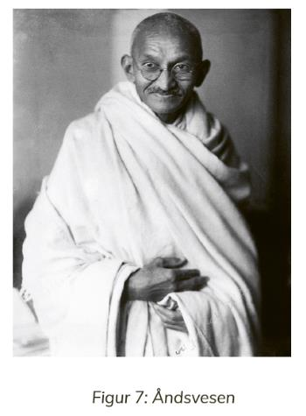
Being a Spiritual Being
Having a personality at this level
Focus: To serve a higher purpose than personal needs by being a servant of good (God) and creating a good whole (holiness).
Center of Control: The Soul and Spirit.
Characteristics: A person at this level lives in harmony with their soul and follows their calling. The soul often has spiritual contact and experiences guidance from the spiritual world. Personal needs have taken a back seat.
Very few people become spiritual beings with spiritual contact all the time. But we can all go in that direction.
Being a serving person, for example in voluntary organizations, is something that many of us are.
Mahatma Gandhi

