Slide 1

Life guidance for our time
Lecture series for increased life mastery and enjoyment of life
Course instructor: Per Hjalmar Svae
Session 8:
Developing Sensitivity and Empathy, and Living From the Heart
Heart Room Self-development School hjerterommet.no

Slide 2
Developing Sensitivity
There is a difference between feelings and emotions.
Emotions
Strong emotional reactions when you are triggered by something.
  The emotional brain (the mammalian brain) and the survival brain (the reptile brain) take control of the psyche, unconsciously and automatically.
  For example: irritated, angry, jealous, frustrated, embarrassed, annoyed.
Feelings
More subtle feelings you can notice when you are not triggered.
  You are calm and safe so that one of the higher control centers is in charge: the “thinking brain,” the heart, the soul, the spirit.
  For example: happy, sad, tired, energized, longing for, etc.

Slide 3
Developing Sensitivity
Where attention goes, energy flows, so it grows!
Techniques for getting in touch with feelings
Moving the body releases tension so that feelings
can surface and be noticed consciously
Go for a walk, calmly and relaxed, and let your thoughts wander freely
Free dancing to rhythmic music
Free movement to music, making sure to move all parts of the body, then sit down and listen inward
Conversations about personal matters
What do I experience and feel? What may lie behind these feelings?
What do I really feel?
Meditation and witnessing awareness – Mindfulness
Feel, feel, feel. What do I feel?
Meditate and quiet the mind so you can notice the feelings
Witnessing awareness so you can notice the most subtle feelings
Ask questions and invite answers: What do you want, long for, and ask for? = what the heart and soul want
Sleep on it. Retreat. Therapy.

Slide 4
What lies behind the words of others, and your own thoughts?
Where attention goes, energy flows, so it grows!
Method for raising awareness of emotional communication.
Factual message – Thought
What do the words say factually,
if we ignore all emotional content?
Head
Heart message – Feelings
What feeling lies behind the words?
Anger, jealousy, envy, frustration…?
Joy, desire, longing, care…?
Heart
Gut
Gut message – Will
What is the real intention behind the message?
What do you read from the body language?
Is pressure applied to achieve something?

Slide 5
List of feelings
Feelings That Can Be Felt When Needs Are Met
Peaceful | Happy | Loving | Playful | Excited | Safe | Grateful | Hopeful
Relaxed | Cheerful | Accepting | Energetic | Enthusiastic | Confident | Moved | Optimistic
Free | Content | Tender | Enthusiastic | Delighted | Flexible | Tender | Alive
Calm | Merry | Affectionate | Eager | Overwhelmed | Spacious |  | Interested
Satisfied | Radiant | Warm | Lively | Proud | Powerful
Fulfilled | Joyful | Touched | Curious | Engaged | Comfortable
Harmonious | Happy | Friendly | Fascinated | Encouraged
Relieved |  |  | Quick | Surprised
Source: https://www.ivk.no/laer-mer/

Slide 6
List of feelings
Feelings That May Arise When Needs Are Not Met
Sad | Fearful | Angry | Tired | Frustrated | Confused
Lonely | Afraid | Irritated | Tired | Discouraged | Unstable
Hurt | Uneasy | Upset | Exhausted | Uncomfortable | Doubtful
Unhappy | Nervous | Bitter | Indifferent | Shy | Suspicious
Depressed | Anxious | Furious |  | Tense | Embarrassed
Desperate | Insecure | Mad |  | Dissatisfied | Amazed
Grieving | Unsafe | Enraged |  | Opposed
Feeling down | Distrustful |  |  | Pessimistic
Helpless | Fearful |  |  | Disgusted
Low-spirited | Suspicious |  |  | Vulnerable
Hopeless | Jealous |  |  | Reserved
Disappointed |  |  |  | Jealous
 |  |  |  | Restless
 |  |  |  | Guilty
 |  |  |  | Worried
 |  |  |  | Impatient
Kilde: https://www.ivk.no/laer-mer/

Slide 7
Developing Sensitivity Can Be Challenging
It is a challenging process because
you must let go of some mental control.
You may become more emotional
You become more vulnerable because you feel more
You are more often disappointed because people are ego‑driven
➔You must develop inner protection
instead of outer protection and mask energy

Slide 8
Inner protection vs. outer protection
Outer protection
Spend less time with the person who hurts you, or break contact
Protection through mask energy
Defend yourself. Attack back. Argue.
Grit your teeth and endure it.
Inner protection against being hurt
First take in what the other says and feel it
Then accept that the other says and does what they do
→ That is how they are, and it is livable
Then accept what the other says about you
→ If it is true, acknowledge it and forgive yourself
→If it is not true, choose to tolerate and live with
not being seen for who you are
Inner protection is simply standing on your own feet and not demand anything from others. You accept reality as it is, tolerate it, and live well with it.

Slide 9
Developing the Ability for Empathy and Attunement
Understanding the difference
between sympathy and empathy
Sympathy
Feeling sorry for someone and feeling with them.
Sympathy is a parent‑child communication.
You are the “parent” (adult) feeling for “the poor child.”
Empathy
You genuinely feel with the other.
Empathy is an adult‑adult communication.
You relate to the other as someone capable of carrying their own feelings.

Slide 10
Empathy – How to Do It in Practice
Attunement
Keep focus on the other, listen and notice
Look the other in the eyes, an appropriate amount
What is the person saying?
What is the facial expression? Body language?
Can you “read” any feelings from what you observe?
What feelings and motivations lie behind? What is said “between the lines”?
Try to put yourself in and feel the other’s situation (attunement)
Empathy – Follow – Understand – Feel with
Nod, make small sounds to show you hear and follow
Ask follow‑up questions of factual or emotional nature (not mental)
Express compassion for the other’s situation, experience, and feelings (empathy)
Rule: Adress the feeling first, then you may address the issue.
First adress the feeling — listening, showing empathy and compassion.
Only afterwards can you address the issue, when the other is ready for it (That is: In the window of tolerance again).

Slide 11
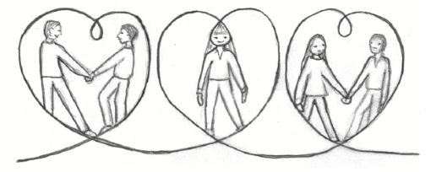
Living From the Heart and
Being a Fellow Human Being
Focus: Having good intentions and doing your best in all relationships.
Center of guidance: Heart‑based considerations, heart feelings, goodwill, and high ethics.
Characteristics:
Both‑and thinking; trying to consider several things at once
Both‑and actions; caring for others and yourself
Able to remain an independent individual despite close, mutual relationships
Able to make good judgments, say wise things, and make good decisions

Slide 12
Heart Communication vs. Ordinary Conversation
Ordinary conversation is often fragmented and self‑assertive
People take the word, grab the word, even before others are finished.
You must be ON, constantly saying something to stay in the game.
What is said often does not follow up what the previous person said.
If you don’t speak for a while, you fall out of the conversation.
For others, it is as if you are no longer there.
The talk is about being included, being funny, being informed, etc.
    Everyone asserts themselves in the competition for attention.
    It is extremely rare that someone brings back those who have dropped out.
You can view ordinary conversation as a card game:
Everyone has a stack of cards.
Before too long, you must play a card — otherwise you’re out.
Playing a card = saying something.

Slide 13

Being a Fellow Human Being Who Creates Heart Connection
Focus exclusively on feelings, not the issue
Facts (the situation) are mentioned only as background for the feelings
Focus on the essential and the real
Let the word be like a ball rolled gently back and forth
Present what you say without pushing it
The other picks it up and lets it sink in
Then comes the other’s response: a sound, a question, a few words…
Every response follows up what the other said
This can be mutual or caregiving heart contact:
Mutual heart contact: both speak from the adult part of the psyche
Caregiving heart contact: one is overwhelmed and functions from the child part; the other gives care like a “parent”

Slide 14
Example of Heart‑Based Communication
Jorunn: How are you? It’s a pretty tough situation you’re in now.
Magnus: Well, I guess I’m okay…
Jorunn: Yes, in a way you probably are. But how are you really?
Magnus: Really? Uh… well. Actually, I’m quite angry at Fredrik for pushing me out of the company.
Jorunn: Yes, that must have felt like a betrayal…?
Magnus: YES! It’s terrible that someone can do something like that!
Jorunn: Do you also feel sadness that your friendship is over? You were childhood friends. You had so many great trips, parties, and other things together.
Now Jorunn has managed to get through Magnus’s mask, and he begins to cry.
Sadness is deeper than anger, and tears can release and heal what has happened inside Magnus, even if the outer situation cannot be repaired.

Slide 15
Bringing the Heart Into The Communication
­Giraffe language is a method developed by psychologist Marshall B. Rosenberg, described in the book Nonviolent Communication. See ivk.no .
Expressing needs
Facts | What is it that you hear, see, or experience?
Feelings | What do you feel in response to this?
Needs | What are your needs, wishes, or longings that you want to be met?
Request | Ask others for what you want.
Example of expressing needs
This week you have hardly cleaned the kitchen (fact)
I notice that I’m starting to get irritated (feeling)
I need us to share the responsibility of keeping the kitchen tidy (need)
Could you take a larger share of the cleaning, about half? (request)

Slide 16
To bring your heart into the comunication
To live in (hear it – feel it)
Facts | What do you hear, see or experience in the other person?
Feelings | What do you think that person feels from this? (Asked as a question)
Needs | What do you think is the other person's underlying need, desire, or longing? (Asked as a question)
Example of empathic attunement
I notice It seems to me that you are quite irritated.
Are you actually angry, or furious, at Kari?
… Wait for and take in the reaction:
“Yes, I guess I am pretty angry at her!”
Do you perhaps need and wish that she wouldn’t be so dominant?
“Yes, she is/does xxx and yyy and it’s terrible!!!”
Are you actually a bit sad that you can’t be more equal, good friends?
“YES!”

Slide 17
List of Needs
Nourishment | Safety/Trust | Calm/Tranquility
Touch | Protection | Relaxation
Movement | Predictability | Balance
Exercise | Continuity | Simplicity
Rest | Order/Structure | Peace
Sleep | Reliability | Harmony
Recreation | Self-esteem | Self-care
Well-being | Confidence | Calm
 | Stability | Beauty
 | Support/Help | Silence
 | Trust | Spirituality
Source: https://www.ivk.no/laer-mer/

Slide 18
List of Needs
Freedom | Creativity | Me
Authenticity | Play | Efficiency
Autonomy | Renewal | Contributing
Agreement | Having fun | Celebrating
Integrity | Humor | Giving/Receiving
Power / Inner strength | Inspiration | Hope
Self-insight | Passion | Competence
Independence | Excitement | Learning
Spontaneity | Challenge | Goals
Openness | Exploration | Response
Honesty | Development | Result
 |  | Coherence
Kilde: https://www.ivk.no/laer-mer/

Slide 19
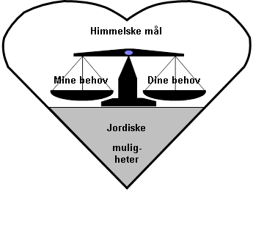

Creating Cooperation From the Heart
The Heart Solution Method
Heavenly goals
My needs
Your needs
Earthly possibilities

Slide 20
Example using The Heart Solution Method
A Couple Planning Their Summer Vacation
Their “heavenly goal” is to meet both partners’ needs as well as possible.
The wife’s needs:
Get a real break from everyday life in rainy Bergen.
Get a taste of “the sweet life”.
The husband’s needs:
Not such an expensive vacation that it requires overtime or creates debt.
Relax without having to visit many museums and attractions.
Their suggestions:
Cabin vacation in Norway combined with restaurant visits and an exclusive spa experience.
Trip to southern Europe early in the season when travel is cheaper, without too many excursions; the wife may take some excursions alone.
Sensual “southern trip” with romantic meals in the apartment, a visit to a romantic restaurant, affection and swimming — no excursions.
Evaluation
Then they have a good and creative dialogue about what to choose.

Slide 21

Living From the Heart Is About Two Things
Love your neighbor as yourself! (Jesus)
Loving yourself
Desire, need, wish, and longing are the words the heart uses to speak to you. By listening to and following them, you live from the heart = self‑care and self‑realization.
Loving others
Å Being a good fellow human being means letting nature’s demands and others’ needs matter as much as your own, both in daily life and in difficult decisions.
Where attention goes, energy flows, so it grows!
If you focus on staying connected to and functioning from the heart in daily life, your heart will open more and more.
(Because what you give energy grows, and what you don’t give energy diminishes.)

Slide 22
Perception of Love at
Different Cultural Stages
Kulturelt trinn | Oppfatning av kjærlighet
5. Spiritual Culture | Care for the whole, Serving effort
4. Heart Culture | Mutual listening and care + Loving the other
3. Democratic Culture | Fulfilling one's duty + good dialogue, good friendship and cooperation
2. «Medieval Culture» | Obedience
1. «Viking Culture» | Total lojality

Slide 23
To develop high ethics
that make you walk the talk
The masculine side of living from the heart is having high ethics.
This ethic is about principles and behavior that prevent you from letting your emotions and lower reactions affect others.
For example, if you are subjected to something unfair and unreasonable and become angry at those behind it, you do not let this anger take its toll on them.
Instead, you seek inner peace and tranquility within yourself, so that you can calmly and objectively come to an appropriate response as a mature adult.

Slide 24
Communication in different ways and levels
Level | Fear = Worse Motivation from 1. and 2. level | Safety = Better Motivation from 3. and 4. level
5. Spiritual Culture | Being taken by fear, distrust and greed, and breathing this into the world. | Having courage, trust in the good, and goodwill, and breathing this into the world.
4. Heart Culture | Closed heart = Egoism. Forgetting to think of others. Wishing others harm. | Open heart = Equal weight on own and others’ needs. Listening communication. Seeking heart‑based solutions.
3. Democratic Culture | One‑sidedness, irrationality, lies, distortion, exaggeration, minimization. | Calm and balanced conversation. Democratic decisions. Clear agreements and rules.
2. Medieval Culture | Emotional, overly intense communication; anger, scolding, condemning, ridiculing, alliance‑building. | Balance of power. Respecting boundaries. Agreements and compromises everyone benefits from.
1. Viking Culture | Physical, psychological or economic violence and threats. | Cooperating to meet everyone’s needs. Following agreements and rules

Slide 25
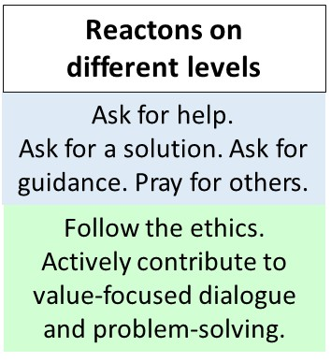
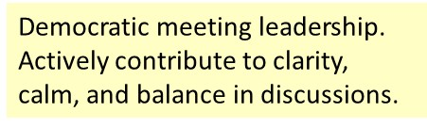
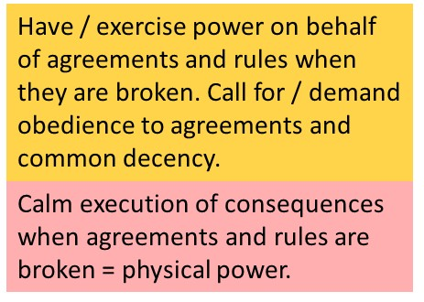
Going up, or down low as an emergency response
You are in the tolerance window inside you. But you do not tolerate what others do outside of you.
Reaction on the spiritual level
Going up:
Reaction on the heart level
Normal mode and communication
Where we usually are and get others to cooperate through calm dialogue, encouragement, negotiation.
Going down:
Motivation on 3. level, but you react on 2. or 1. level.
You respond in an emotional mode. You become sharp in your voice, raise your voice, demand, command.
You respond on the physical level. Calmly and objectively, you give the child or person a logical, physical consequence.

Slide 26
Becoming a Caring Fellow Human Being Who Lives From the Heart
This involves:
Developing sensitivity and the ability for attunement and empathy.
You focus on feeling and becoming aware of what you actually feel.
You learn to be quiet, listen, notice, and feel what others feel.
Developing high ethics so that you walk the talk.
Inside yourself you can feel everything, but you do not take negativity out on others. (possibly only as a symbolic expression)
Deciding to live from the heart
Meaning you have as much care for others as for yourself —
all the time.
Where attention goes, energy flows, so it grows!

