Slide 1

Life guidance for our time
Lecture series for increased life mastery and enjoyment of life
Course instructor: Per Hjalmar Svae
Session 7:
Being in life energy and being able to change between life energy and mask energy
Heart Room Self-development School hjerterommet.no

Slide 2
Pierrakos' model of the human psyche
The Mask (The ego)
Learned patterns to cope with life.
Positive Mask Energy (Mastery)
What we do to adapt and make the best out of things when we can't be natural.
Being nice, competent, overworking, etc.
Positive mask -
Negative Mask Energy (Discontent)
Discontent, struggle, or withdrawal when facing something we dislike or can't accept.
Feeling angry, jealous, frustrated, etc.
Negative
mask
Core: Life Energy
Life energy– Natural being
Innate lust for life, needs, abilities and life mission
Life energy– Natural being
Contact with deeper feelings and longings, joy, heart, soul, and creativity.
If good situation: Joy of life, love, creativity
If bad situation: Feel fear, sorrow, pain or nausea

Slide 3
Am I in positive mask energy or
in life energy and feeling well?
Positive Mask Energy (Mastery)
Looking forward to getting it done, feeling good about having cleaned up, enjoying recognition and praise, pride, a sense of accomplishment = the joy of achieving
Positive mask
Life energy – natural being – If good situation:
Positive energy and life expression related to all seven chakras and aura layers in the human energy system (electromagnetic field) that surrounds, creates and maintains the physical body.
Negative
mask
Core: Life energy
According to Pierrakos, the Core with life energy
is our true self. CORE = Center Of Right Energy.
The mask is learned patterns that are not ourselves. The mask is nevertheless enduring character traits that largely define our personality and behavior.

Slide 4
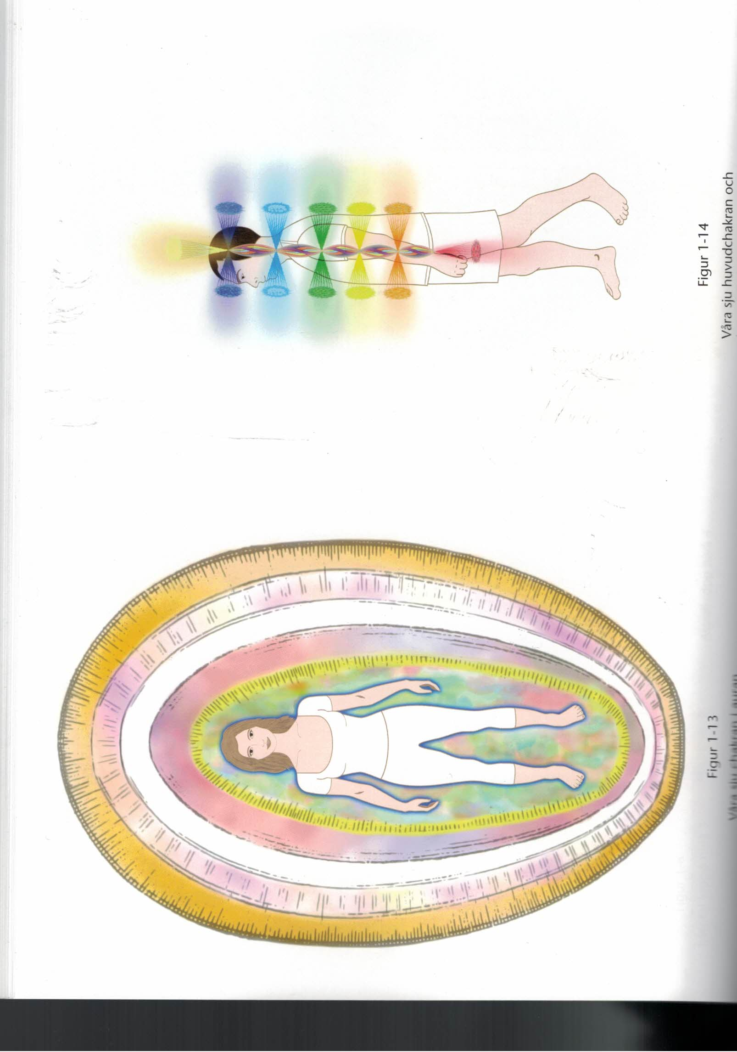

Life energy on different life planes
Life energy – natural being – If situation is good:
7. Crown Mindfulness, divine awareness
6. Third Eye Intuition, divine love
5. Throat Creativity, deeper meaning
4. Heart Love, care, joy
3. Solar Plexus Insight, "Aha!" moments
2. Hara Sensuality, bubbling joy
1. Root Physical pleasure and sensory enjoyment
The human energy system
Source: Barbara Ann Brennan:
Core Light Healing

Slide 5
Am I in negative mask energy or in life energy where circumstances are not good?
The difference is that in negative mask energy you don't accept reality.
Negative mask energy – Dissatisfaction
Outgoing: Dissatisfied, frustrated, angry, jealous, envious, spiteful, malicious, cold, harsh,
Introverted: Disappointed, paralyzed, worried, can't cope, discouraged, melancholy, depressed. Feeling shame, guilt, embarrassment. Feeling of failure, inferiority complex, feeling worthless, dissatisfaction with one's own appearance, etc.
Positive mask -
Negative
mask
Core: Life energy
Life energy – natural being – Bad situation:
Feeling fear, sorrow, pain, or nausea are the underlying emotions that are masked and reduced through negative mask energy, or coped with through positive mask energy.
In life energy, you accept reality and feel what it means to you.

Slide 6
Brainwave States and Consciousness
Outwardly directed life energy. Inspiration and creativity
Gamma waves (25 to 100 Hz)
– An enthusiastic, inspired, energized, happy state
Gamma waves are associated with high-level cognitive processing tasks. Ability to take in completely new information and see new wholes. Wave of new insight and creativity. High peaks of gamma waves are seen during states of happiness.
Alfa waves (8 to 13 Hz)
– When we calm down, relax and give ourselves free. Mindfulness.
When we lie on the couch and watch TV or relax in bed, but before we fall asleep. By light meditation and mindfulness. Let go of the mask and come into life energy.
Theta waves (3,5 to 8 Hz) (The Earth has 7,8Hz)
– Deep awareness and meditation, hypnosis, regression, channeling.
Related to imagination, reflection and sleep. When we relax and let our imagination “fly”. Deep meditation and contact with the essence of life.
Spiritual contact and experience.
Delta waves (1 to 3 Hz) – Deep dreamless sleep. Very deep wakefulness, trance. Very common in babies and young children. The older we get, the fewer of these brain waves we produce, other than in deep, dreamless sleep.
Beta waves (12 to 33 Hz) – Our everyday awareness
Increased inner contact with the core of life, the spiritual and unconscious

Slide 7
Two ways to be in life energy
Free and conscious expression of life – “Being-doing”
You are freed from “autopilot” – Unconscious, automatic ego patterns.
You consciously choose your way of being and actions.
If you do this out of desire/care/intuition, not out of duty, and living in the present is as important as the result, it is life energy.
Life energy – Natural being
Life energy – natural being – When it is good:
7. Being, mindfulness. Divine awareness.
6. Feeling divine love and contact, intuition
5. Enthusiasm, creativity, experiencing deeper meaning
4. Love, being fond of, loving, desire to care
3. Joyful insight and realization. Aha! Eureka!
2. Bright, bubbling joy of life, sensuality
Physical pleasure in the body and via sensory impressions
When it is bad:
Feeling fear, sorrow, pain, or nausea

Slide 8

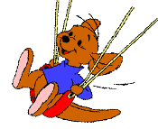




Free and conscious expression of life –
“Being-doing
To be in the positive resource of each of
the six ego patterns, in a balanced way
Being particularly gifted and at the same time part of the community
Being vibrant, fun, social and/or artistic and at the same time giving space and room for others
Being mentally strong and at the same time sensitive
Being strong-willed and at the same time democratic and with respect for the needs, opinions and boundaries of others
Being caring and at the same time self-sufficient and able to set boundaries
Being responsible and at the same time open and sensitive, self-sufficient and caring towards others

Slide 9
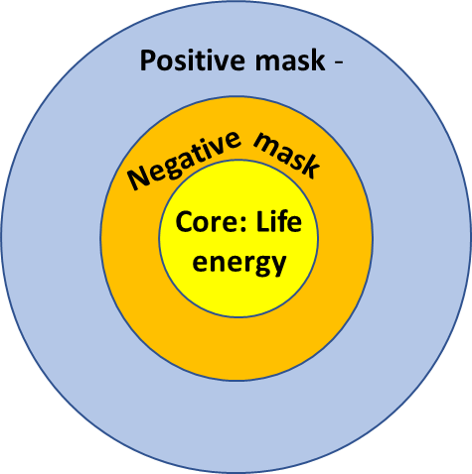
How do you come into life energy– Natural being?
1. Paradox
You can't do anything to get into life energy. If you do something to achieve something in the future, you are in mask energy, performing energy.
Therefore, the method is "doing nothing"
Seek outer peace so that you can feel within yourself, not be disturbed (security) and not have to do anything.
Do not do anything that lasts over time and becomes a project that must be completed. Go from doing to being.
Feel your feelings well. Only do what you feel like, which you are sure is not positive mask energy.
Calm down, go slowly and feel more deeply.
What do you feel?
This is how you enter a process of increased openness, increasing emotional contact and following your desires, heart and intuition.
When you do this:
- You will have alpha waves
- Blood pressure sinks
- Heart rythm slows down
- Oxygen consumption lower
MD. Deepak Chopra
➔ The body rests while sensitivity and awareness increase.

Slide 10
The process of getting deeper into contact
with yourself and your life energy
Seek solitude and stress relief, preferably for an hour every day. Meditate. Go on a retreat. Arrange a cabin vacation and seek inner peace for a week.
Let go of obligations and denials. Play music that touches you. Meditate.
Search inward: Reflect on yourself and your life
How did I function in that situation? What did I feel? What was my motivation? What was my real need?
What is it that you really want, desire, long for and pray for?
Visualize it. These four words are what the essence of life uses to speak to you. By visualizing this and putting emotions into it, you become like a magnet that attracts it to you.
Ask questions, ask for answers, and just let it lie there in the background
Sooner or later an answer will come from the subconscious or the spiritual world.
Write thoughts, feelings and dreams in a diary
The process of points 2, 3 and 4 goes deeper into you if you write down your reflections in a diary. You can also write down dreams and try to interpret them.
Be open to new ideas and impulses, feelings and thoughts, and to follow them up

Slide 11

How do you come in life energy?
2. Paradox
When you let go of the positive mask, you can end up in the negative mask.
Negative mask energy – Dissatisfaction
Outgoing: Dissatisfied, frustrated, sour, angry, jealous, envious, spiteful, malicious, cold, harsh
Introverted: Depressed, paralyzed, unable to cope, discouraged, melancholy, depressed. Feeling shame, guilt, embarrassment. Feeling of failure, inferiority complex, feeling worthless, dissatisfaction with one's own appearance, behavior, etc.
Clean water immediately comes only if you have processed and made conscious negative repressed emotional memories from the past and negative programming (neg. mask energy), and lived in free and conscious life expression and life energy/being.
Rusty or clean water from the source?

Slide 12
Two choices when you end up in the negative
Exit
Start performing again.
1. Paradox
You can't do anything to get into life energy.
If you do something to achieve something in the future, you are in mask energy, performing energy.
Stay in contact with the negative
Feel it and sink deeper into it,
until it goes away on its own.
(That is, through acceptance,
recognition, and forgiveness.)

Slide 13
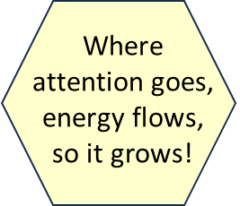
Self-observation, self-reflection and testing are also the way out of fear, anxiety, anger and other negative energy.
Put into words that you are overcome by fear/ distrust/ negativity/ anger/ blame. For example, worry, distrust, anger, condemnation, lack of courage, despair, overachieve-ment, etc. That is, all forms of emotions that are deeply rooted in fear and distrust.
Stop and take a time-out
Stop yourself from continuing to act out of fear or one of its many derivations.
Witness the fear/negativity and engage in self-observation and self-reflection
Let the fear/negativity be in your mind and engage in self-observation and reflection.
  What are you really feeling? What do you feel like doing? Why?
  Behind fear/negativity/anger there is often an unmet need. Put words to this need. In this way you can find out what is causing it and what need you really have.
  You can also talk to others about it.
When fear calms down, think and act with positive motivation (testing alternatives)
Contact that place in your heart that is filled with kindness, compassion, and forgiveness toward yourself and others, so that you can come into positive energy. Then you devise a way to communicate and act that best meets the need.
The wisdom behind the method is: What you give energy to, grows in the psyche.
What you do not give energy to, diminishes. By witnessing the fear and simply reflecting on it, you do not give energy to the fear. No life-enegy flows to it!
Source: Penny Gill: What in the World Is Going On? – Wisdom Teachings for Our Time

Slide 14
Some advice and precautions on
the way out of the negative
All feelings are allowed.
Not all actions are allowed. Ethics, morals and etiquette apply.
You speed up the process through conversations and journaling:
  About how you really feel?
  About what you really want, wish, long for and pray for?
  + taking steps in the desired direction.
If you can't get rid of a negative feeling, you can try symbolic expression.
"There is no shame in turning around".
If it gets too "heavy", you can switch to positive mask energy.
It is your responsibility to consider what is wise.

Slide 15
What can you do if negative energy won't let go?
For example, one of these feelings: Worry, fear, blaming others, anger, jealousy, envy, shame, guilt, hopelessness, etc.
Meditation
Try to actively witness the negative thoughts and feelings. Now that you witness them, they are something you have, but not something you are anymore. For example: You have anger in you, but you are no longer an angry person.
Talk to someone else about it.
Or write it down. It can release it. By putting it into words, you get some of the energy that is pent up. The releasing process is acceptance, recognition and forgiveness.
Distraction
Do something that captures your attention and takes it away from the negative. Watch a nice movie. Chop wood. Do a demanding job.
Symbolic expression
Do symbolically what you feel like doing. Write the angry words you want to say, and throw it away. Hit a pillow, wring a towel, etc.

Slide 16
Warning!
The technique of daring to let go of the positive mask and remain in negative mask energy and simply witness and reflect on negative thoughts and feelings – so that the positive life energy can eventually emerge –
is not completely harmless!
There are two possible outcomes:
You come through the “darkness”
You are taken by the “darkness”.
To succeed, you must have a mature personality!

Slide 17
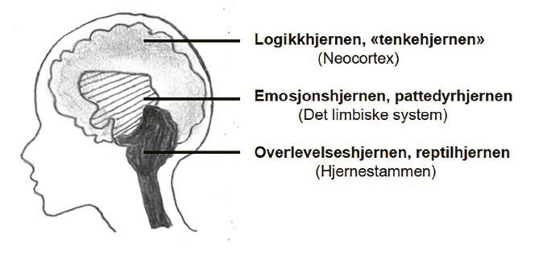
Personal maturity
Which brain controls you the most?
The analytical brain, «the thinking brain»
(Neocortex)
The emotional brain, the mammal brain
(The limbic system)
The survival brain, the reptile brain
(The brainstem)
The tripartite brain

Slide 18
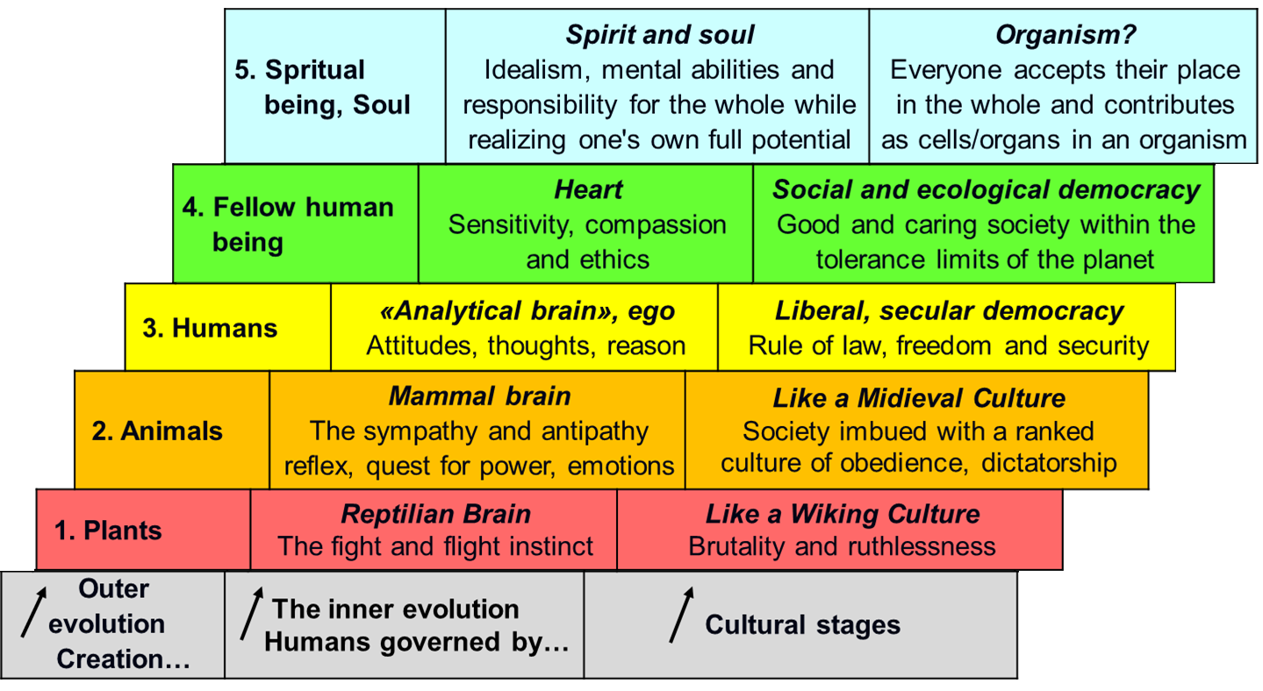
To have a mature enough personality
The cerebral cortex and the ego must be the dominant control center when going through, processing and becoming aware of the "darkness", i.e. negative mask energy and repressed negative emotional memories.
Positive motivation At the top three levels, it is security, trust and caring that govern emotions, thoughts and actions. ➔ Create something positive
Negative motivation
At the two lowest levels, fear, distrust and greed (egoism) control emotions, thoughts and actions. ➔
Create something negative
The reason for this is that you have to let go of mental control to get into life energy. If you have little mental control to begin with, the lower brains can get the upper hand = "the darkness wins."

Slide 19
Being able to switch between
mask and life energy
Aspect | Mask Energy Mastery – Self control Let the outer control the inner. Adaption to outer demands. Pretending. Playing a role. | Life Energy Free life expression Let the inner affect the outer. Listen to inner feelings. Be how you actually are now.
Spirit | Choosing to be as required and doing what one must | Choosing to be oneself and doing what one desires
Head | Obligations and denials: Should, must, and ought to | Creative thinking to meet needs and follow desires
Heart | Sense of responsibility for the outer world; plans and deadlines | Sense of care for the inner world; nurture and express in the present moment
Stomach | Willpower takes control. Loses emotional connection | Tuning in, feeling, and following needs and desires
Body | Mental control. Rigidity. Duty-driven work | Bodily connection. Sensuality. Life expression

Slide 20
Some characteristics of being in life energy
Safe and good inner peace within oneself
Open up, become relaxed, warm and happy
Get in touch with your own, deeper feelings, needs and longings
Feel good about yourself and get closer to each other
Get inspired and become creative and productive
Experience and understand meaningful encounters
Recognize and tolerate sadness, fear and pain, without losing hope and courage
Ailments subside or become weaker
Increased security, courage and trust, without becoming overoptimistic
The opposite of this is a sign of mask energy

Slide 21
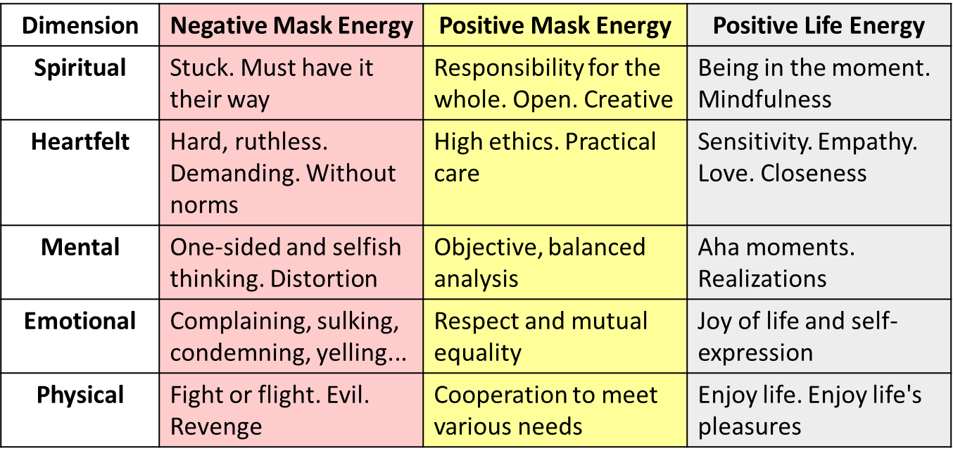
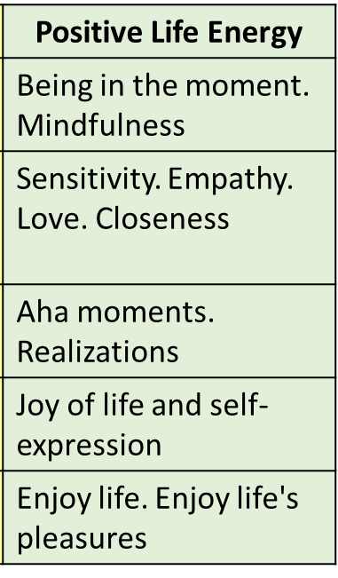
The process of personal development
Dependency
Lower brains
Selfreliance
«Thinking brain»
Mutuality/Intimacy
Lust, heart, soul and spirit
Negative feelings
Mastery feelings
Deeper sensuality

Slide 22
Recognizing different forms of mask energy
The expressions of the mask energy (ego)
MASK ENERGY IS: | POSITIVE - LIFE GIVING | NEGATIV - LIFE LIMITING
INWARD-DIRECTED | Demands of oneself Feels duty, need for mental control | Rejects, condemns, or punishes oneself Feels failure, guilt, shame, embarrassment, ....
OUTWARD-DIRECTED | Demands of others Feels entitled, obligated, or compelled to guide towards others | Rejects, condemns, or punishes others Feels the need to educate others so they stop doing what they do
Underlying these patterns of action is always fear, distrust, and greed (egoism), which results in making demands of oneself or others.

Slide 23
Recognizing different forms of life energy
The expressions of life energy (the self)
LIFE ENERGY IS: | POSITIVE - LIFE GIVING | NEGATIVE– LIFE LIMITING This is the motivation behind negativ mask energy
INWARD-DIRECTED | Accepting oneself, others, and the world as it is Feeling pleasure, desire, joy or fear, sorrow, pain, nausea | Wanting to escape, flee, or die Feeling that it is unbearable
OUTWARD-DIRECTED | Giving of oneself without demanding anything in return Feeling creativity, love, willingness to care | Wanting to remove, destroy, or kill Feeling anger, rage, hatred
Beneath positive life energy there is always security, trust and a willingness to care, which results in accepting ourselves and others as we really are.

Slide 24

Self-development is like making a new path in the forest.
What we do in practice is creating new, well-functioning brain pathways and letting old, inappropriate brain pathways weaken and die out.
First you have to figure out where the new path is going to go
Then you have to make the path and step and step to make it a path
Then the old path slowly grows back because you don't use it
…. And finally the new path has become easy to walk
= Finding a good way of being or a good alternative to the undesirable, e.g. always being in the tolerance window.
= Practicing and practicing being in the tolerance window and practicing the core star.
= you no longer fall into the old pattern and become emotional.
= the new and better has become automated, being in the tolerance window.
Free course: Life guidance for our time
hjerterommet.no/livsveiledning/

Slide 25

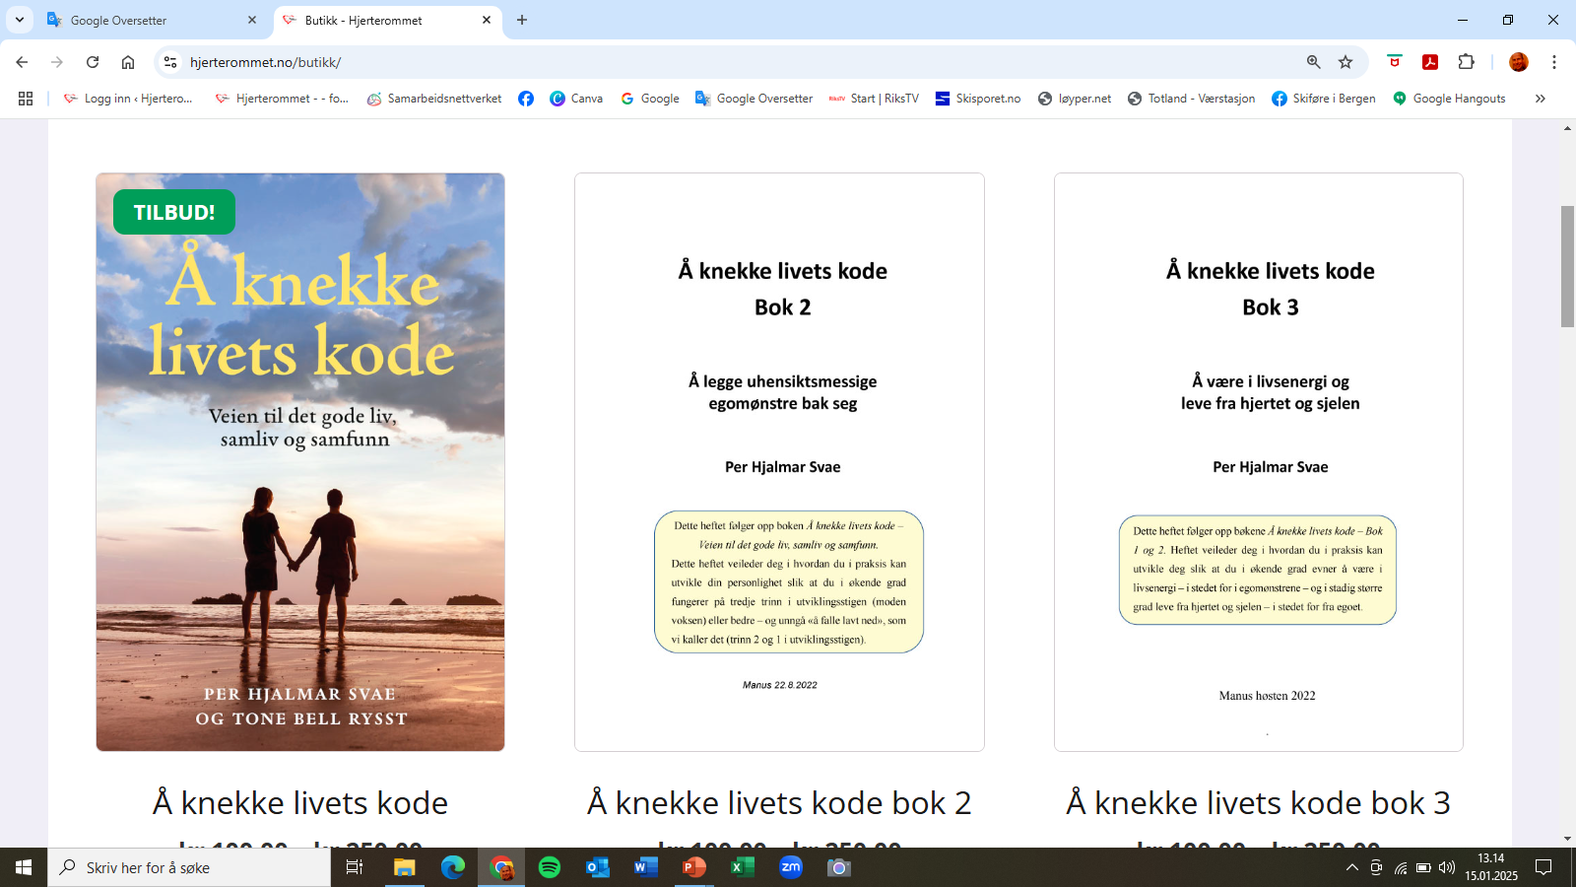
Book and compendiums
Available as pdf-files in Norwegian, which you can use webtools to translate to your language
Breaking the Code of Life - A Path to Good Lives, Partnerships and Society
A5 – 260 pages
Book 2: Leaving Inappropriate Ego Patterns Behind
A4 – 116 pages
Book 3: Leaving Low Energy Behind
A4 – 98 pages

