Slide 1

Life guidance for our time
Lecture series for increased life mastery and enjoyment of life
Course instructor: Per Hjalmar Svae
Session 6:
Coping with Life Crises
and Moving Forward in Life
Heart Room Self-development School hjerterommet.no

Slide 2
Life Crisis
A life crisis is a situation or
transition that is overwhelming.
It is experienced as a greater burden than one has the resources or strength to handle.
Often, a sense of mastery, self-worth and social identity are threatened, and our self-esteem is challenged.
Life crises are a natural part of life
Life crises occur in every human life.
The crises are not equally severe or profound for everyone, but they do come.
They may be sudden and unexpected burdens, such as serious illness or accident, the death of someone we love, losing one’s job, relationship breakdown, betrayal and loss of trust, financial loss, fire/natural disaster.
They may be traumatic crises, such as rape, violence, accidents, bullying and harassment, suicide of someone close, or war.
They may be major life transitions, such as moving away from home, starting a new education, earning one’s own income, having children, or retiring.
https://favne.no/samtaleterapi/livskrise/

Slide 3
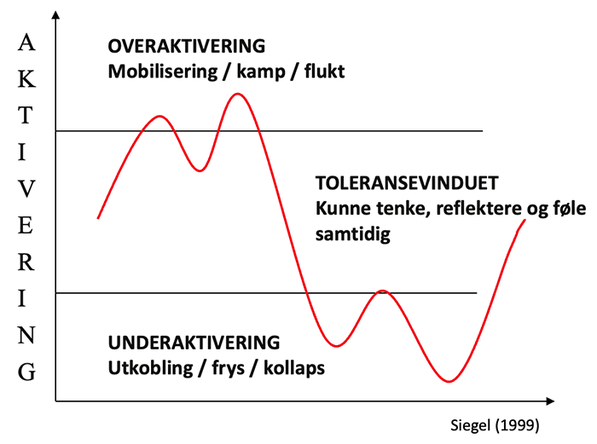
In a life crisis you are outside the window of tolerance
Overactivation – Negative outward-directed mask energy
Often recognized as restlessness, anger, bitterness, acting out, racing thoughts, etc.
Typical reactions for different ego patterns:
A
K
T
I
V
I
S
A
T
I
O
N
OVERACTIVATION
Mobilizing/ fight / physical flight
Emotionally existentially insecure – Over-willed (Undernourished)
THE WINDOW OF TOLERANCE
Are abel to think, reflect and feel at the same time
Overperforming pattern, while suppressing emotions
Mentally existentially insecure – Submissive (Undernourished)
UNDERACTIVATION
Disconnect /Freeze/ Collaps / Psycic flight
Underactivation – Negative inward-directed mask energy
Often recognized as low mood, emptiness, dissociation, distance, shame, guilt, embarrassment, etc.
https://www.traumebehandling.no/behandle/psykoedukasjon/toleransevinduet/

Slide 4
Four typical phases in a life crisis
Shock Phase – Hours or days
- Inner chaos, panic, or apathy. Sense of unreality.
- Physical stress reactions such as sweating, nausea, heart palpitations, trembling,
stomach pain.
Reaction Phase – Days to weeks
- Fear, anxiety, and anger. Guilt or blaming others/fate/God. Possible denial and
repression. Rumination about whether it could have been avoided.
- Re-experiencing the crisis event with despair, anger, crying, grief, and pain.
- Helplessness, depression, sleep disturbances, and nightmares.
- Reduced tolerance for psychological stress and reduced work capacity.
Repair and Processing Phase – Weeks to months
- Gradually reconciling with what happened.
- Defense mechanisms decrease. Strong emotions lessen.
- Less rumination and increasing functioning again.
Reorientation Phase – Often after about 6 months
- Opening up to the world again. Old interests are resumed.
- Beginning to create a new life on new terms.
- Life goes on.
Late effects and relapses are not uncommon.
New events can resurface old wounds..
Source: Psykiater Johan Cullberg (2003).
https://nhi.no/forstehjelp/akuttmedisin/diverse/krisehjelp-psykisk?page=8

Slide 5
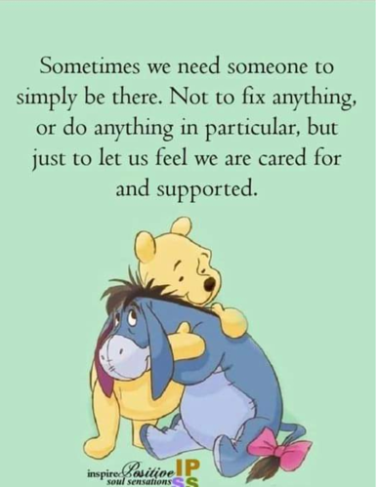

Slide 6
Four keys to dealing with life crises
Do not fight the feelings. Accept them and move through them.
- What do you feel? Sadness, grief, fear, anxiety, pain, anger, regret, something else?
- Be aware that earlier negative experiences and traumas may be activated.
- Be open to reassessing values, beliefs, and goals.
Ask for help.
- Talking with others about what you are going through always helps emotionally.
- Talking with others who have been through something similar is useful.
- Asking for advice and help is allowed, and may be necessary.
Know that life crises are temporary.
- Life crises have a beginning, a development, a climax, and an end.
- Life crises are an opportunity for change, but the opportunity must be taken.
- Whether we come out stronger depends on ourselves.
Let go of the past to move forward.
- Previous solutions no longer work. “She is dead.” “I am divorced.” Etc.
- Past experiences are valuable, but not something we can cling to.
- Life crises force us to face our insecurity and weaknesses.
- By letting go of the past, acknowledging insecurity and weakness, and going
through the emotions, we can eventually focus on the future and move on.
https://utforsksinnet.no/handtere-livskriser/

Slide 7
Is the situation more than you can handle?
Seek professional advice!
Call an SOS hotline.
Seek contact and advice from experts or peers.
Seek professional help!
Talk to your general practitioner.
Seek professional help: psychologist, therapist, etc.
Contact the municipality’s crisis support services.
Contact a school counselor or safety representative in cases of bullying.
Contact the police if you are exposed to threats or violence.
Contact a crisis center if necessary.
Etc. depending on the situation.

Slide 8
Two ways to cope with a life crisis
By being like a fortress
Shutting off emotions and suppressing them.
Advantage: You avoid feeling the negative emotions as strongly.
Disadvantage: You create a negative emotional memory in the psyche that you spend energy suppressing for the rest of your life.
  A variation is being a fortress that shoots at others.
  You blame others or external factors for what happened.
  Advantage: By sending your strong inner emotions outward, you avoid feeling your inner despair, fear, grief, pain, regret, guilt, loss of self-worth, etc.
  Disadvantage: Psychologist John Berglund says: “You choose to be a victim. You become a bystander in your own life. You hand over initiative and responsibility to others.”
By being like a beach – the recommended way
Let the emotions wash over you and wash out again.
Advantage: You deepen your ability to feel, develop the ability to stand in demanding emotional tension, and avoid creating repressed emotional memories.
Disadvantage: You feel the strong painful emotions for as long as they last, which can be a long time during a life crisis.

Slide 9
Being like a beach where
emotions wash in and out
You allow yourself to be emotionally affected
by the situation, live through it, and endure
the emotions for as long as they last.
  Be in despair about the situation and feel the fear.
  Feel the sadness and cry.
  Think that what the other person is doing is terrible and be angry.
  Feel that you can't bear to live anymore, but don't take your own life.
  Etc.
The deeper life-energy emotions you must tolerate to heal emotionally are:
Fear, grief, pain, and/or nausea.
Try to contact and feel one of these
emotions to move forward in the process

Slide 10
What can you do if the
emotions do not subside?
Meditation – Witness the feelings – Let them be there, observe them without ‘listening to them’ or thinking from them.
Talk with someone about it.
Or write what you feel in a journal, read it, and reflect on it.
Distraction – Watch a pleasant movie, read a book, take a trip, etc.
Symbolic expression – e.g., take out anger on what you are angry at by ‘beating up’ a pillow, ‘strangling’ a towel, ‘kicking a pillow to death,’ etc. Or write a letter expressing what you truly feel and think, but never send it—burn it instead.

Slide 11
Some practical tips during life crises.
Be especially careful with alcohol use during this period.
Reduce caffeine intake, which can cause restlessness and sleep difficulties.
Remember to eat normally and maintain regular sleep routines.
This helps you return to your normal life rhythm.
It is important to resume physical activity and other things you did before.
https://www.ung.no/psykisk/Sorg-og-krise/2605_Slik_kan_du_takle_en_krise.html

Slide 12
What if the years pass and it is heavier than you can bear?
Then you can try following this advice:
If the years pass and it is heavier than you can bear,
you must put it aside and move on with life!

Slide 13
What do you do when others
are struck by a life crisis?
The most important thing is not what you say or do,
but that you are there for the other person
as a fellow human being:
Through listening, understanding, human connection, empathy, care, support.
By being someone to share thoughts and feelings with.
By letting the other person know you are there for them whenever needed.
By being honest and saying, for example: ‘I don’t know what to say right now.’
‘Is there something I can say, do, or be for you in this situation?’
Sometimes it is best not to say anything. Dare to be in silence.
Let tears or other emotions come. It is okay to cry yourself.
The most important thing is to receive and listen to the feelings, not try to remove them. Do not say things like: ‘Don’t take it so hard,’ ‘It will pass,’ ‘You’ll get through this like others have,’ etc.
https://sykepleien.no/forskning/2017/10/slik-kan-du-mote-mennesker-i-krise

Slide 14
Being there for someone outside
the window of tolerance
The person in a life crisis is overwhelmed
and therefore, outside the window of tolerance.
To be there as a fellow human being for someone outside the window of tolerance, you must yourself be within the window of tolerance.
What you must do is receive the emotion/affect through sensitive listening. You are accepting and attentive. With nods, sounds, or words, you confirm that you have heard and taken in what is said. With gentle, exploratory questions, you can also listen more deeply to what the other feels, thinks, and wants.
This creates a safe base where the other feels seen and met.
This helps the other return to the window of tolerance—back to coping.
Only when the other is safe, calm, and within the window of tolerance again can you address the matter. What can and should the person do? But this may take days, weeks, or months.
The concepts of the window of tolerance and sensitive listening come from the Secure Base Model for raising children.

