Slide 1
Life guidance for our time
Lecture series for increased life mastery and enjoyment of life
Course instructor: Per Hjalmar Svae
5th time: Living with and, at best, getting rid of personality challenges.
Heart Room Self-development School hjerterommet.no

Slide 2
Each of the ego patterns have their personality challenges
Existentially insecure – Mental variant Seeks freedom from responsibility, instead of taking responsibility for one's own life and for the community. ➔ Flight pattern
Existentially insecure – Emotional variant Excessive need for attention, instead of being loved for who one is. ➔ Hysteria pattern
Malnourished Seeks mental contact, instead of emotional contact and physical contact. ➔ Pattern of being unrealistic
Strong-willed Pushing one's own will through, instead of mutual listening, caring and cooperation. ➔ Fighting pattern
Submissive Seeking to have a nice and cozy time, even if one's own needs are not met. ➔ Yielding pattern/Submissive pattern
Over-achieving Over-responsibility for plans and matters, at the expense of the emotional. ➔ Over-overachievement pattern

Slide 3
What I am about to present is within the tradition of cognitive behavioral therapy
An important goal of cognitive behavioral therapy is to break self-reinforcing vicious cycles of thoughts, feelings, and actions that maintain mental health problems, including through assistance with self-help.
What we are going to look at now is about becoming aware of problematic patterns, and with the power of thought and will, being able to break out of these patterns. The goal is to think, feel, and act more appropriately in the same situations that trigger the patterns.
What we are going to go through now is help for self-help, similar to what you do in cognitive behavioral therapy, and especially in the direction Schema therapy.

Slide 4
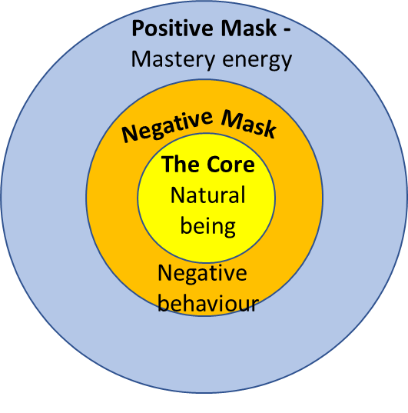
Prof. Dr. Franz Ruppert’s model of the human psyche
Part 3: Traumatized Part
This part is in a helpless, overwhelmed state, and can trigger the worst aspects of the ego patterns.
Part 2: Survival Strategies
The positive and negative sides of ego patterns
All the other lectures than this one, are based on Psychiatrist John Pierrako's model of the human psyche
Part 1: The Healthy Part The Core of Life, Self, Heart, Soul

Slide 5
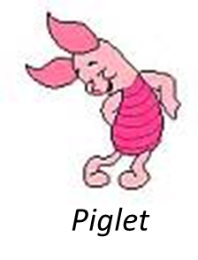
Existentially insecure – Mental variant
Flight pattern and coping with it
The trigger is always the same for each pattern

Slide 6
Flight pattern and coping with it

Slide 7
Getting out of negative energy that won't let go
Put into words that you are overcome by fear/ distrust/ negativity/ anger/ blame. For example, worry, distrust, anger, condemnation, lack of courage, despair, overachieve-ment, etc. That is, all forms of emotions that are deeply rooted in fear and distrust.
Stop and take a time-out Stopp deg selv i å fortsette å handle ut fra frykten eller en av dens mange avledninger.
Witness the fear/negativity and engage in self-observation and self-reflection Let the fear/negativity take over your mind and engage in self-observation and reflection.
What are you really feeling? What do you feel like doing? Why?
Behind fear/negativity/anger there is often an unmet need. Put words to this need. This way you can find out what is causing it and what need you really have. You can also talk to others about it.
When fear calms down, think and act with positive motivation (testing) Contact that place in your heart that is filled with kindness, compassion, and forgiveness toward yourself and others, so that you can come into positive energy. Then you devise a way to communicate and act that best meets the need.
The wisdom behind the method is: What you give energy to, grows in the psyche. What you do not give energy to, diminishes. By witnessing the fear and simply reflecting on it, you do not give energy to the fear.
Source: Penny Gill: What in the World Is Going On? – Wisdom Teachings for Our Time

Slide 8
Flight pattern and and coping with it

Slide 9
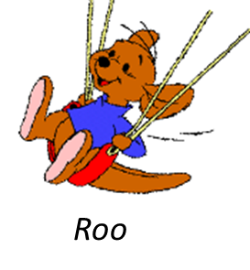
Existentially insecure – Emotional variant
Hysteria pattern and coping with it

Slide 10
Hysteria pattern and coping with it

Slide 11
Existentially insecure – Emotional variant
Narcissistic tendencies and coping with it

Slide 12
Malnourished
Pattern of being unrealistic and coping with it

Slide 13
Pattern of being unrealistic and coping with it

Slide 14
Pattern of being unrealistic and coping with it

Slide 15
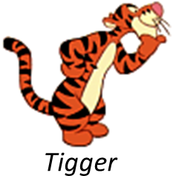
Strong-willed: Fighting pattern and coping with it

Slide 16
Fighting pattern and coping with it

Slide 17
Fighting pattern and coping with it

Slide 18
Submissive: Submissive pattern and coping with it

Slide 19
Submissive pattern and coping with it

Slide 20
Submissive pattern and coping with it

Slide 21
Over-achieving: Over-overachievement pattern and coping with it

Slide 22
Over-overachievement pattern and coping with it

Slide 23
Over-overachievement pattern and coping with it

Slide 24
If a pattern is permanently at its worst, it leads to mental illness
Existentially insecure – Mental variant Seeks freedom ➔ Flight pattern ➔ Schizofreni, autism spectrum
Existentially insecure – Emotional variant Excessive need for attention ➔ Hysteria pattern ➔ Narcissism
Malnourished Lives in the mental world ➔ Pattern of being unrealistic ➔ Bipolar
Strong-willed Pushing one's own will through ➔ Fighting pattern ➔ Psychopathy / -tendecies
Submissive Avoids conflict ➔ Submissive pattern ➔ Masochism
Over-achieving Over-responsibility ➔ Over-overachievement pattern ➔ Morbid rigidity, burnt out

Slide 25
You leave inappropriate patterns behind through self-observation, self-reflection and testing
Self-observation How did I function today? How did I function in that conversation? How did I function in that company, at that meeting, in that situation? You can also ask others what they think of you and what you did.
Self-reflection Why did I do what I did? Was it fear? Was it mistrust? What did I really want to achieve? What was my need in that situation? What ego pattern was I operating in? What step on the developmental ladder was I operating on? Why did the other person(s) react the way they did?
Experimentation What could I have done that would be functioning at 3rd, 4th or 5th step on the development ladder? Think of one or more good reactions and courses of action. How and when can I put this into practice? Try it out.
+ therapy and coaching?

Slide 26
Ego patterns are also resources
The overachieving ego pattern is the resource you use to:
Get out of a flight pattern
Get out of a hysteria pattern
The strong-willed and overachieving ego patterns are the resources you use to:
Get out of a surrendering pattern
The surrendering and overachieving ego patterns are the resources you use to:
Get out of a fight pattern
The overachieving ego pattern is the resource you use to:
develop yourself; reflect on yourself, make wise choices, stay focused and practice and practice what you want to develop.

Slide 27
Coping when other people's personalities and behaviors become a challenge for you
Two keys:
1. Being in the tolerance window
To be calm, balanced, constructive and objective.
The way we are when we:
do not get emotional to get our way
do not give up and let relationships or something in ourselves die.
In other words: Being on the 3rd step of the development ladder.
2. The power lies in the consequences
If you want to change behavior in others, you first use words, e.g. "giraffe language.“
Giraffe language
Facts
Feelings
Needs
Request
If it has become "intolerable", the power lies not in the words, but in the consequences.

Slide 28
Self-development is like making a new path in the forest.
What we do in practice is creating new, well-functioning brain pathways and letting old, inappropriate brain pathways weaken and die out.
First you have to figure out where the new path is going to go
Then you have to make the path and step and step to make it a path
Then the old path slowly grows back because you don't use it
…. And finally the new path has become easy to walk
= Finding a good way of being or a good alternative to the undesirable, e.g. always being in the tolerance window.
= Practicing and practicing being in the tolerance window and practicing the care star.
= you no longer fall into the old pattern and become emotional.
= the new and better has become automated, being in the tolerance window.
Free course: Life guidance for our time
hjerterommet.no/livsveiledning/

Slide 29
Book and compendiums
Available as pdf-files in Norwegian, which you can use webtools to translate to your language
Breaking the Code of Life - A Path to Good Lives, Partnerships and Society
A5 – 260 pages
Book 2: Leaving Inappropriate Ego Patterns Behind A4 – 116 pages
Book 3: Leaving Low Energy Behind
A4 – 98 pages

