Slide 1
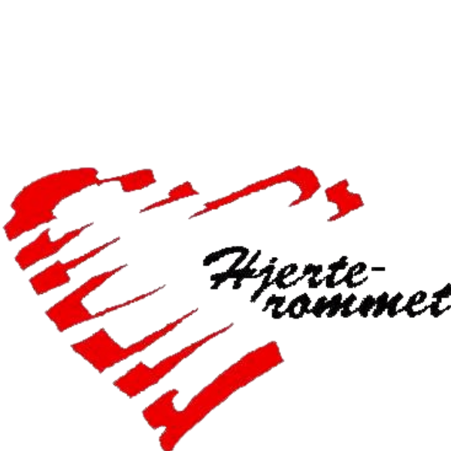
The six ego patterns
A key to understandig yourself and others better
Per Hjalmar Svae
Heart Room Self-development School hjerterommet.no

Slide 2
What is an ego pattern?
An ego pattern is an automated pattern of thought, feeling, will and body postures that has become a permanent character trait.
The patterns are formed during the first six years of life. Most people have several patterns in their personality.
The professional source of the ego patterns is body-oriented psychology.
Wilhelm Reich: Character Analysis (1933, 1949 expanded edition) See for instance: http://energeticsinstitute.com.au/psychotherapy-counselling/characterology/
Alexander Lowen (1976): Bioenergetics.
John Pierrakos (1990): Core Energetics: Developing the Capacity to Love And Heal.
Barbara Ann Brennan (1993): Light Emerging. The Journey of Personal Healing
Lisbeth Marcher (2010): Body Encyclopedia. Bodynamic Theory. Se: https://www.bodynamic.com/theory/

Slide 3
The ego patterns – A resouce and a problem
As children, we learn to cope with life as best we can.
We develop an ego with automated reaction patterns - Ego patterns. An ego pattern is an automated pattern of thought, feeling, will and body postures that has become a permanent character trait.
The ego patterns are created to make the best of it in a situation where we as children are not met the way we really need.
➔ Resource
The ego patterns are automated, locked-in patterns that we repeat as adults, even if it is not appropriate. ➔ A Problem
The pattern provides substitute solutions (eg, getting one's way) rather than needs satisfaction (eg, mutual care and good cooperation).
You automatically repeat behavior that may be inappropriate.
In the case of stuck problems in cohabitation and cooperation, the negative aspects of the ego patterns are a part of the problem.

Slide 4
Two variants of the first ego pattern
Note: In body-oriented psychology (bioenergetics, core energetics and bodynamic) you operate with five ego patterns (character defences).
In Bodynamic, a Danish variant of the tradition, it has been found that there are two variants of each pattern, depending on whether it is formed in the early or late phase of the period when the pattern is formed in childhood.
For the existentially insecure ego pattern (Schizoid), these two variants are like night and day (introverted versus extroverted). Therefore, we have chosen to call these two variants their own ego patterns. So, there are not five, but six ego patterns.
The emotional variant of the existentially uncertain ego pattern is therefore not found in Rreich's, Lowen's, Pierrakos' and Brennan's books, but it is similar to the sanguine type in ancient tradition.

Slide 5
Existentially insecure – Mental variant
The child's life theme in the phase -0.3 - + 0.3 years:
Do I have a right to exist? Am I wanted?
The cause of the pattern is a birth trauma, being an unwanted child or neglect in the form of hostility, violence, neglect or aloofness at the start of life.
Piglet
Replacement solution
Split. Pull away
Freedom from responsibility
Self-worth and self-esteem
Negative. Feeling unwanted
Not feeling good enough as you are
Feeling like you don't fit in

Slide 6
Existentially insecure – Mental variant
Typical Characteristics and Properties
Piglet
Positive Properties Stage 3 (Stage 3 in The Development Ladder, see 1st lesson in the Course)
Often a special mental or spiritual endowment.
Radar for other people's hidden thoughts and feelings
Unbound by "tribal laws"
Ability to have deep and serious conversations
Black humor
Negative Properties – Stage 2 in the Development ladder
Struggling with fear, anxiety and negative thoughts.
Melancholy. Downcast, pessimistic basic mood
Often distant and mental
Can struggle with social things
Resistance to change. Becomes paralyzed.
Shrugs off responsibility
Periods of melancholy and depression
Poor life skills

Slide 7
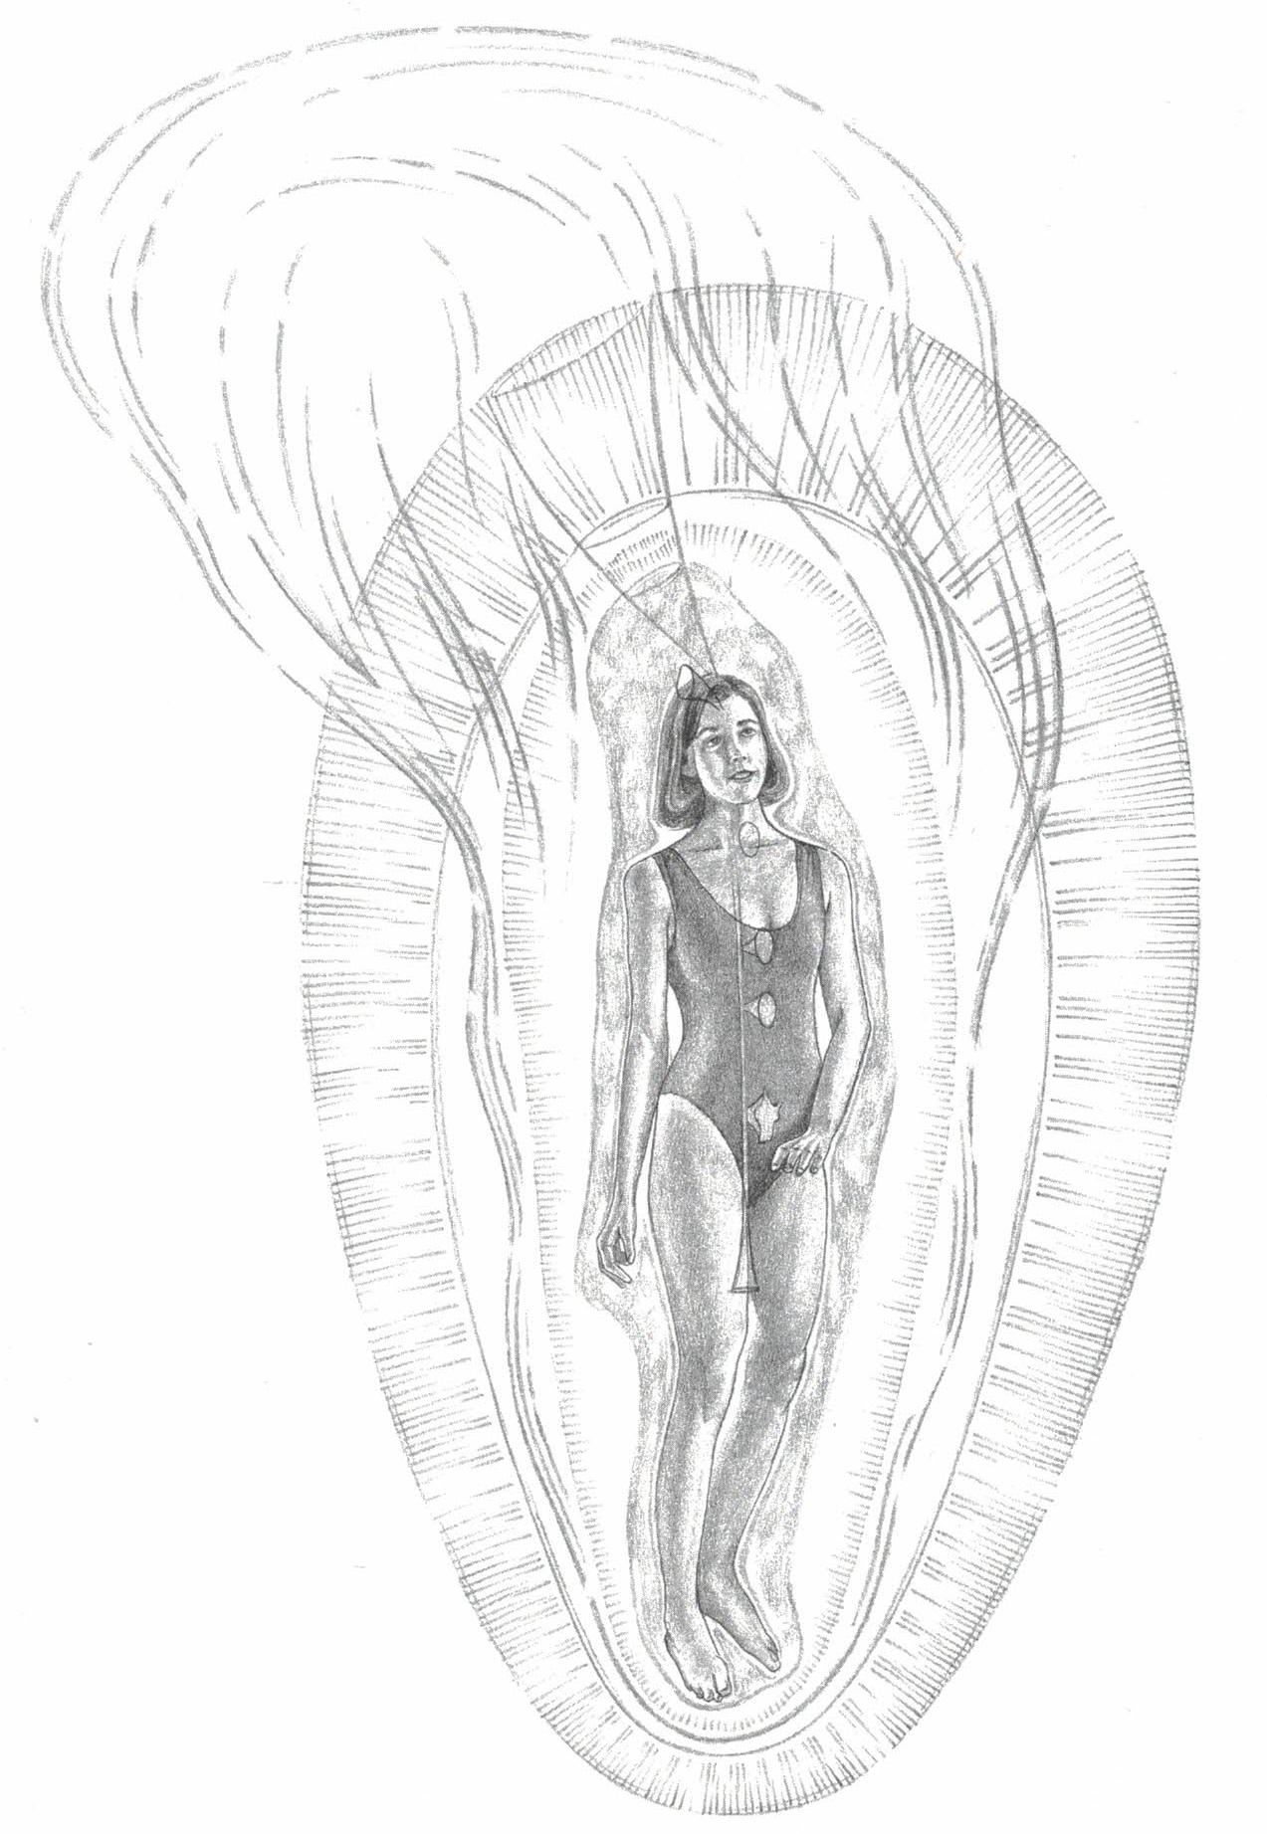
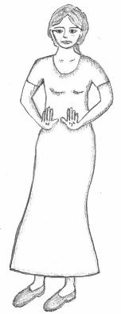
Existentially insecure – Mental variant
Piglet
Body shape is a tendency that often recurs. Of course, heredity, environment, diet and exercise also play a role.
Typical body:
Fragile and hinged.
Light and airy. Crooked. But most often other patterns will affect the body more.
Typical use of the life energy: Withdraws away from one's own body and others and upwards towards spiritual spheres
Source: Barbara Ann Brennan: Light Emerging

Slide 8
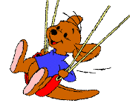
Existentially insecure – Emotional variant
The child's life theme in the phase 0 - 0.3 years: Am I worth being loved?
The reason for the pattern is that they only experienced being loved and cared for as they are for shorter periods of time, so that they learned to get more energy and attention from their parents through attention-generating behavior.
Roo
Repacement solution
Seeking attention, instead of being loved as you are
Playing through life, instead of taking responsibility
Self-worth and self-esteem
Self-esteem: Consciously, they like to feel valuable and festive.
Self-worth: Unconsciously, they don't feel worth anything if they don't get attention.

Slide 9
Existentially insecure – Emotional variant
Typical Characteristics and Properties
Roo
Positive Properties – Stage 3
Often special social and artistic abilities
Contact with the life core and life energy
Sanguine. Extroverted, fun-loving and playful.
Alive and entertain.
Ability to penetrate others' defenses and create deeper, more genuine connection
Negative Properties – Stage 2
Attention seeking. Take your word and keep it.
Takes the show in social contexts.
Will only do what is pleasurable. Does not like duties.
Gets easily hurt and emotional, e.g. jealousy, envy.
Behaving childishly and creating fuss and chaos
Lose your mind. Hysteria. Destroys things and relationships.
Possibly misuse of alcohol/drugs or unexpected breakdown

Slide 10
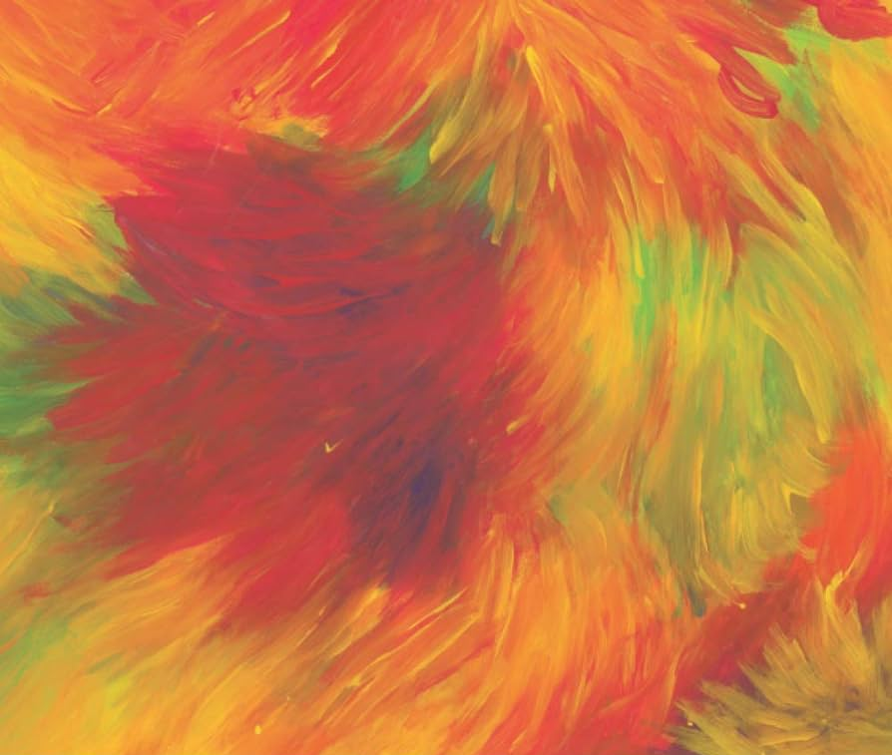
Existentially insecure – Emotional variant
Roo
Typical body:
A living face, facial expressions and body.
The pattern does not appear particularly in the body shape itself, so that other patterns will characterize this.
Typical use of the life energy: Sending out a lot of life energy on several/varying levels

Slide 11
Malnourished
The child's life theme in the phase 0 - 1.5 years: Can I have my needs met and learn to master the body and life?
Eeyore
The reason for the pattern is that there was not enough, or good enough, loving care and good enough cooperation in helping the child meet his needs and cope with life. Possibly also physical malnutrition.
Repacement solution
Mental contact, instead of feeling contact and body contact, both inside and outside
Selv-worth and self-esteem
Self-worth: Can vary.
Self-esteem: Often a sense of being a nerd who is not socially attractive.

Slide 12
Malnourished
Typical Characteristics and Properties
Positive Properties – Stage 3
Mental, logical and analytical abilities
Often a good educator
Kind, straightforward and helpful
Full of ideas and plans
Wry-witted
Eeyore
Negative Properties – Stage 2
Is too mental and has poor emotional contact
Has too little contact with own needs
Malnourished himself. Says no thanks!
Or the opposite: Needy. Gives to get.
Not enough energy and ability to implement ideas and plans
Doesn't understand the issue of power
Alternating overoptimistic and overpessimistic

Slide 13
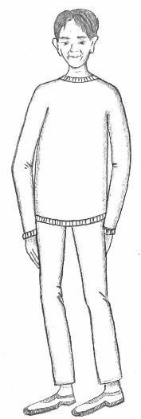
Malnourished
Eeyore
Typical body:
High and thin.
Typical use of the life energy: Suck energy from others

Slide 14
Strong-willed
The child's life theme in the phase 0.8 - 2.5 years: Do I have the right to my own thoughts and feelings?
Tigger
The reason for the pattern is that:
The parents invaded them with their thoughts, feelings and attitudes and demanded that they conform to their will.
Free child-rearing will also be able to create the pattern, because no limits are set for the child's behaviour.
Repacement solution
Get their way instead of dialogue, mutual care and good cooperation.
Self-worth and self-esteem
Self-esteem is inflated. Confident.
The self-worth is bad. Unconsciously, they feel like bad people. Therefore, they cannot stand criticism.

Slide 15
Strong-willed
Typical Characteristics and Properties
Tigger
Positive Properties – Stage 3
Willpower, execution power and leadership skills
Good for building alliances
Charming, confident and humorous
Has a lot of energy and is warm in the body
Eager to train others
Negative Properties – Stage 2
Must be right and must have his will
Choleric. Gets sour and angry easily
Mistrust and demand mentality
Does not respect others' boundaries, selfish
Raises and criticizes everyone but himself
Can't stand being caught off guard and can't stand criticism
Can lie without blinking
Gets energy from being in battle
Don't forget and don't forgive

Slide 16
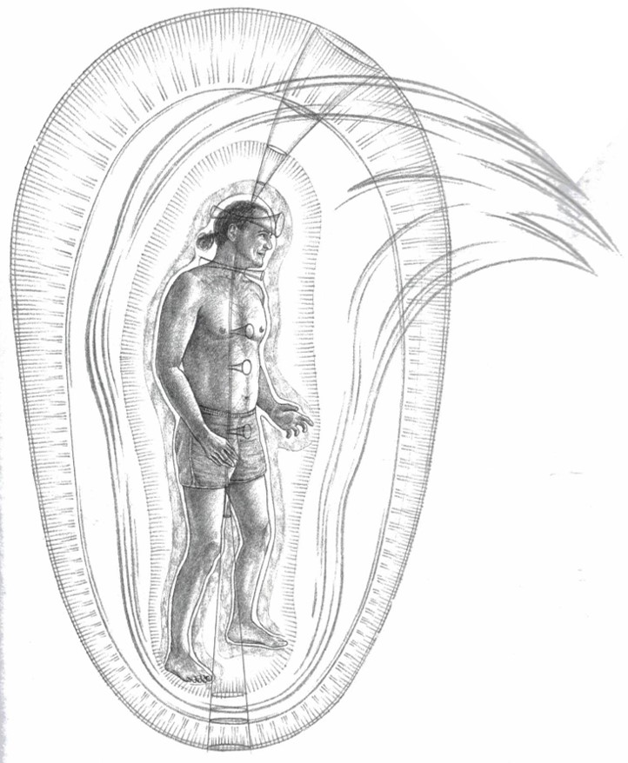
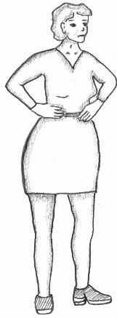
Strong-willed
Tigger
Typical body
Inflated chest
and/or hip part.
Thin legs.
Typical use of the life energy: Pulls the energy up and forward to dominate. Draws energy to the back to increase willpower.

Slide 17
Surrendering
The child's life theme in the phase 2 – 4 years: Do I have the right to my own will?
Winnie The Pooh
The reason for the pattern is that they were regulated in detail and coddled too much as children and obediently surrendered to their parents to get the security, comfort and coziness it provided.
Repacement solution
Be friends and have a good time even if deeper needs are not met.
Self-worth and self-esteem
Tendency to not feel worth anything
Tendency to feel ashamed and embarrassed

Slide 18
Surrendering
Typical Characteristics and Properties
Winnie The Pooh
Positive Properties – Stage 3
Create coziness and coziness. Calm moods.
Has care for everyone
Round and pleasant
Good for conversation
Good diplomats. Sustainable
Can be good leaders
Negative Properties – Stage 2
Surrenders and submits to the will of others
Don't trust your own judgment. Asks/involves others.
Phlegmatic. Indolence and laziness
Often does not master the details of life
Talking about the problems more than going into them
Comfort eating

Slide 19
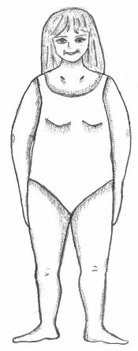
Surrendering
Winnie The Pooh
Typical use of the life energy: Holding the energy back and "letting it pass". This causes the energy field to become large and charged. The emotional layers in the aura are charged more than the structured ones, so judgment and protection become weaker.
Typical body:
Thick all over.
Friendly face.

Slide 20
Overachieving
The child's life theme in the phase 3 – 6 years: Do I have the right to be myself the way I am?
Rabbit
The reason for the pattern is that they themselves and their natural feelings were not seen and appreciated at the age of 4-6, but that they received a lot of recognition and praise for what they achieved.
Repacement solution
Accomplish a lot on the matter level, but don't get to take care of the emotional side. Seeking recognition instead of closeness and contact.
Self-worth and self-esteem
Self-esteem: Feeling valuable and appreciated.
Self-worth: Can vary. Can feel worthless if they do not achieve anything

Slide 21
Overachieving
Typical Characteristics and Properties
Positive Properties – Stage 3
Matter-of-fact, efficient, take responsibility and perform.
Always smiling and positive
Focus on achieving good results
Lots of energy and smiling "always"
Great self-control
Likes boy’s type of play
Rabbit
Negative Properties – Stage 2
The focus is too much on matter in relation to feelings
Hardness, emotional coldness and/or arrogance
Can feel that life is empty and unrewarding
Can take the fur from others
Three variations of personality types: The Seducer, The Idealist, or "The Saint"/God-fearing

Slide 22
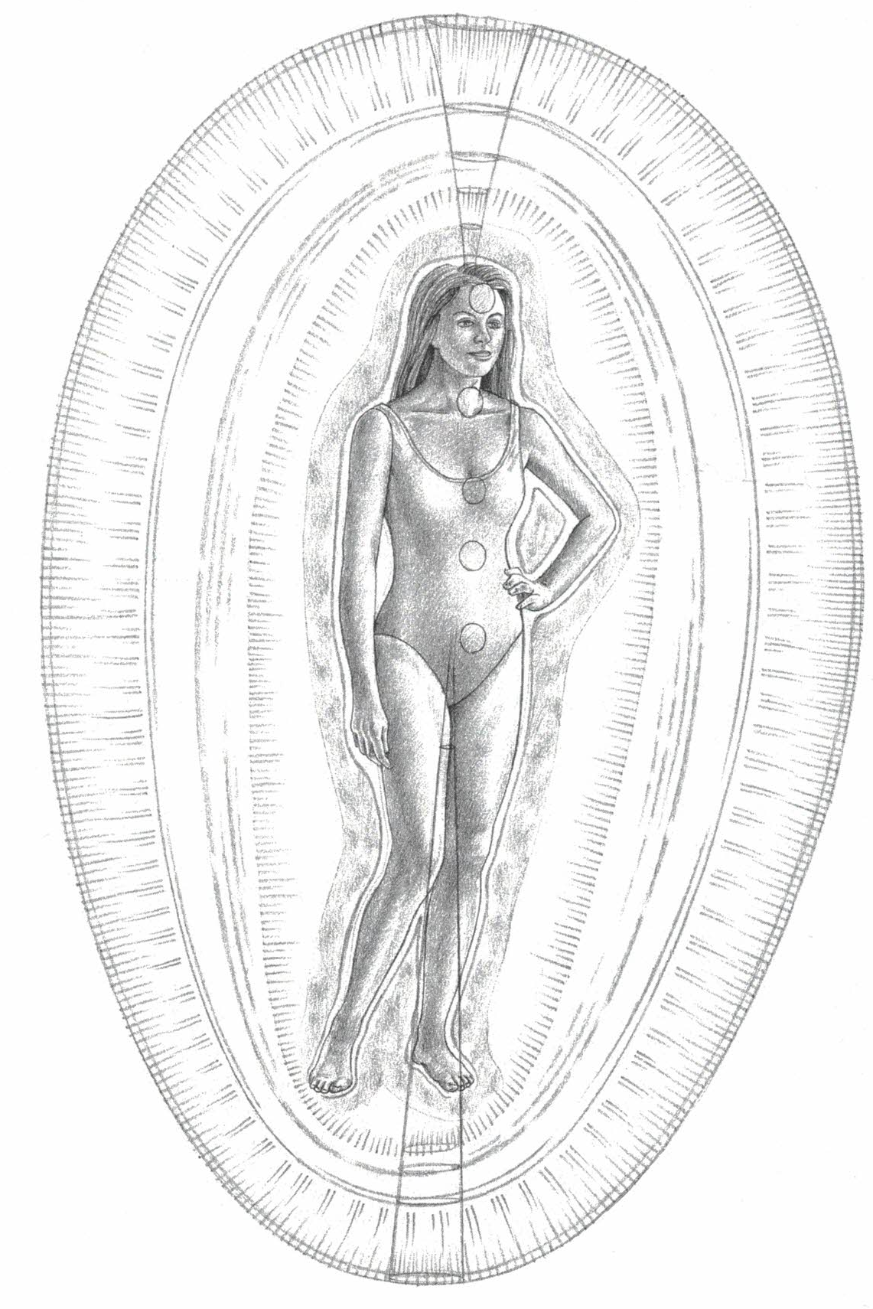
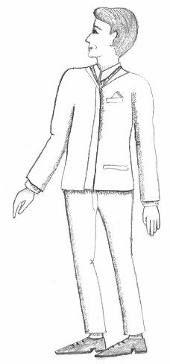
Overachieving
Rabbit
Typical use of the life energy: Keeping mental control. Not having contact with the core of life, the soul. Be and do as you should to be "perfect"
Typical body
Well-proportioned, but stiff in the hips and chest.

Slide 23
The six ego patterns summarized
Winnie The Pooh Character | No. | Egopatterns – negativ og positiv prpperties | Formed by age:
Piglet | 1 | Existentially insecure – Mental and mentally/ spritually giftet | -0,3 – +0,3 year
Roo | 2 | Existentially insecure - Emotional and socially/artistically gifted | 0 – 0,3 year
Eeyore | 3 | Malnourished and mentally/analytically gifted | 0 – 1,5 year
Tigger | 4 | Strong-willed with great implementation power | 0,8 – 2,5 year
Winnie | 5 | Surrendering and caring | 2 – 4 year
Rabbit | 6 | Overachieving and responsible | 3 – 6 year
Source: Body-oriented psychology developed by Wilhelm Reich in the 1930s-1940s, Lowen and Pierrakos in the 1950s-1960s, Barbara Ann Brennan 1980-2020 and Lisbeth Marcher 1990-present.

Slide 24
The six ego patterns some other typologies
Nr. | Egomønster (negativ side) | Typical positive property | Temperament ifølge antikken og antroposofi | DISA-model | Winnie The Pooh Character
1 | Existentially insecure – Mental | Mentally/ spritually gifted | Melancolic | Analytical (blue) | Piglet
2 | Existentially insecure – Emotional | Socially/ artistically gifted | Sanguine | Inspiring (Yellow) | Roo
3 | Malnourished | socially/ artistically gifted |  | Analytical (blue) | Eeyore
4 | Strong-willed | implementation power | Choleric | Dominating (red) | Tigger
5 | Surrendering | Caring | Phlegmatic | Stabil (Green) | Winnie The Pooh
6 | Overachieving | Responsible |  |  | Rabbit
DISA-modellen, Source: Thomas Erikson: Surrounded by Idiots

Slide 25
To come out of the repacement solution
Stand by it and take responsibility for your own life and for the community
Existentially insecure – Mental Seeks freedom from responsibility, instead of standing in it and taking responsibility.
Existentially insecure – Emotional Craving for attention and playing through life, instead of being loved as you are and taking responsibility for duties as well.
Malnourished Seeks mental contact, rather than emotional contact and body contact.
Strong-willed Pushes one's will through, instead of mutual listening, care and cooperation.
Surrendering Looking to have a pleasant and cozy time, even if own needs are not met.
Overachieving Overresponsibility for plans and matters, at the expense of the emotional.
instead of standing in it and taking responsibility.
Love yourself, have close relationships, take responsibility for duties
instead of being loved as one is and taking responsibility also for duties
Seek emotional contact and body contact, in yourself and with others
rather than emotional contact and body contact.
Ask and listen, create good dialogue and cooperation, and be caring
instead of mutual listening, care and cooperation.
Trust your judgement, set boundaries, speak up and take care of deeper needs
even if own needs are not met.
Take emotional care of yourself and others as well
at the expense of the emotional.

Slide 26
You can have a really good life by:
The course Life guidance for our time:
Further develop positive abilities and resources E.g. stable psyche, inner peace, ability to cooperate, ability to carry out, ability to care, etc.
Module 1
Positive Mask - Mastery energy
Leaving negative patterns behind you E.g. worry, fear, grumpy, anger, jealousy, shame, despair, depression, inferiority, low self-esteem, etc.
Module 2
Negative
Mask
The Core Natural being
Develop an ability to be in life energy That is, contact with the life core; our real self, the creative power within us,
the heart and the ability to love, the soul and what we really long for, the spirit and the spiritual.
Negative behaviour
Module 3
The course is based on psychiatrist John Pierrako's model of the human psyche
Module 4
Create a better life and a better world from the core: In love and relationship, as a parent, at work and in society.
Heart Room Self-development School
Contributes with knowledge and offers guidance in this process.

Slide 27
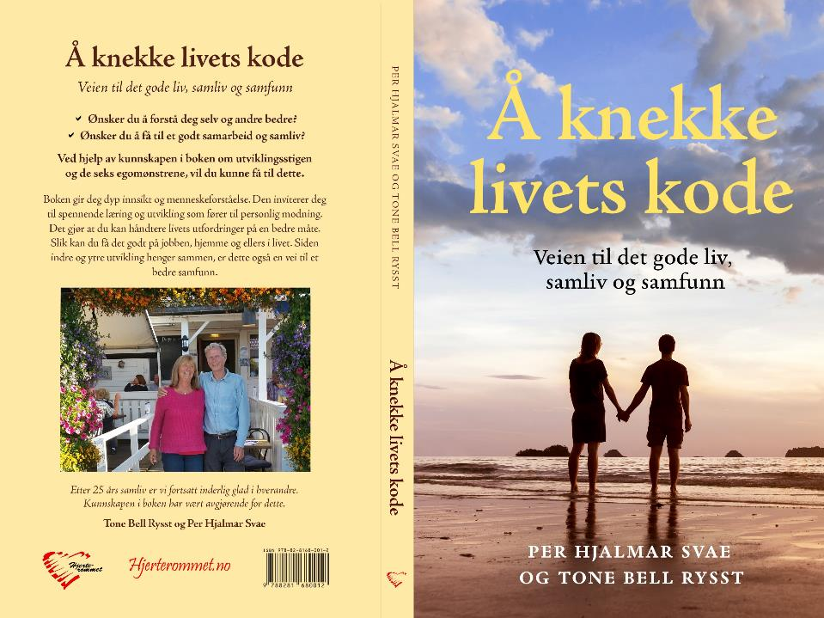
Breaking The Code of Life
A Path to Good Lives, Partnerships and Society
(The book is in Norwegian)

Slide 28
Book and compendiums
Available as pdf-files in Norwegian, which you can use webtools to translate to your language
Breaking the Code of Life - A Path to Good Lives, Partnerships and Society
A5 – 260 pages
Book 2: Leaving Inappropriate Ego Patterns Behind A4 – 116 pages
Book 3: Leaving Low Energy Behind
A4 – 98 pages

